Slide 1
Addition and Subtraction
Bridging
Objectives
Day 1
Y2: Add a 1-digit number to a 2-digit number by bridging multiples of 10 using knowledge of pairs to 10 and place value.
Y3: Add 1-digit numbers to 3-digit numbers.
Day 2
Y2: Subtract a 1-digit from a 2-digit number by bridging multiples of 10 using knowledge of pairs to 10 and place value.
Y3: Subtract 1-digit numbers from 3-digit numbers.
Notes:
Before teaching, be aware that:
On Day 1 and 2 you will need a 0–100 bead bar.

Slide 2
Addition and Subtraction
Bridging
Short Mental Workouts
Day 1
Subtraction facts for 10
Day 2
Subtract 1-digit numbers from teen numbers
Notes:
Choose Workouts that suit your class by dragging and dropping the relevant slide or slides below to the start of the teaching for each day.

Slide 3
Addition and Subtraction
Bridging
Short Mental Workout
Subtraction facts for 10
Notes:
To use this activity, drag this drag this slide to the start of Day 1
Subtraction facts for 10
Show 10 pegs on a hanger. Children close their eyes while you remove 4. How many have gone? Children hold up 4 fingers. Repeat briskly to build fluency.

Slide 4
Addition and Subtraction
Bridging
Short Mental Workout
Subtract 1-digit numbers from teen numbers
Notes:
To use this activity, drag this and the following slide to the start of Day 2
Subtract 1-digit numbers from teen numbers
Say 15 minus 4 and ask children to write the answer as quickly as they can on their whiteboards. Give a cube to each of the first five children to answer correctly. Repeat with other subtractions (subtracting 1-digit from a teen number). Use different mathematical vocabulary for subtraction: subtract, take away, minus, what’s the difference between. The child with the most cubes at the end of the activity is the winner.

Slide 5
Addition and Subtraction
Bridging
Objectives
Day 1
Y2: Add a 1-digit number to a 2-digit number by bridging multiples of 10 using knowledge of pairs to 10 and place value.
Y3: Add 1-digit numbers to 3-digit numbers.

Slide 6
Day 1: Add a 1-digit number to a 2-digit number by bridging multiples of 10 using knowledge of pairs to 10 and place value; Add 1-digit numbers to 3-digit numbers.
We are going to find 28 + 5 on the bead bar.
See how 2 beads make 30, then 3 more beads make 33?
28 + 5 = 33
Notes:
Use a 100-bead bar if you have one. Alternatively use the slide above.
Show 28 beads on the bead bar. Slowly slide a group of 5 beads along to join them.
Point out the next multiple of 10 after 28 and ask children to watch the 2 beads going with 28 to make 30. How many more were added? Point out that 30 add 3 is a PV addition.
Repeat with 38 + 5, then do 68 + 5 and 88 + 5.
Repeat this process to do 25 + 7 followed by 35 + 7, 75 + 7 and 85 + 7. Then show that we can use the same fact to do 37 + 5.

Slide 7
Day 1: Add a 1-digit number to a 2-digit number by bridging multiples of 10 using knowledge of pairs to 10 and place value; Add 1-digit numbers to 3-digit numbers.
Now let’s add 5 to 38, 68 and 88.
What happens each time?
38 + 5 = 43
68 + 5 = 73
88 + 5 = 93
Notes:
Use a 100-bead bar if you have one. Alternatively use the slide above.
Show 28 beads on the bead bar. Slowly slide a group of 5 beads along to join them.
Point out the next multiple of 10 after 28 and ask children to watch the 2 beads going with 28 to make 30. How many more were added? Point out that 30 add 3 is a PV addition.
Repeat with 38 + 5, then do 68 + 5 and 88 + 5.
Repeat this process to do 25 + 7 followed by 35 + 7, 75 + 7 and 85 + 7. Then show that we can use the same fact to do 37 + 5.

Slide 8
Day 1: Add a 1-digit number to a 2-digit number by bridging multiples of 10 using knowledge of pairs to 10 and place value; Add 1-digit numbers to 3-digit numbers.
We are going to find 26 + 7.
How many beads do we need to make 30?
+4
+3
26
33
How many more do we need to add?
What is the answer?

Slide 9
Day 1: Add a 1-digit number to a 2-digit number by bridging multiples of 10 using knowledge of pairs to 10 and place value; Add 1-digit numbers to 3-digit numbers.
Now we are going to calculate 46 + 7.
+4
+3
46
53
Draw a label after the 46th bead.
How many more do we need to add?
How many beads to the next 10?
What is the answer?
Notes:
Ask a child to draw a label after the 46th bead.

Slide 10
Day 1: Add a 1-digit number to a 2-digit number by bridging multiples of 10 using knowledge of pairs to 10 and place value; Add 1-digit numbers to 3-digit numbers.
Now let’s find 56 + 7.
Can you predict the answer?
+4
+3
56
63
Draw a label after the 56th bead.
How many more do we need to add?
How many beads to the next 10?
What is the answer?
Notes:
Ask a child to draw a label after the 46th bead.

Slide 11
Day 1: Add a 1-digit number to a 2-digit number by bridging multiples of 10 using knowledge of pairs to 10 and place value; Add 1-digit numbers to 3-digit numbers.
We are going to work out 25 + 8.
How many beads do we need to make 30?
+5
+3
25
33
How many more do we need to add?
What is the answer?
Where is that on the line?

Slide 12
Day 1: Add a 1-digit number to a 2-digit number by bridging multiples of 10 using knowledge of pairs to 10 and place value; Add 1-digit numbers to 3-digit numbers.
We are going to find 45 + 8.
Label 45 on the line.
How many more do we need to add?
Where is the answer?
How many to the next 10?
What number fact do we use?
50 + 3 is a place value addition. We do NOT need to count on in ones.
Notes:
Ask a child to label 45 on the line.

Slide 13
Day 1: Add a 1-digit number to a 2-digit number by bridging multiples of 10 using knowledge of pairs to 10 and place value; Add 1-digit numbers to 3-digit numbers.
We are going to work out 68 + 5.
Label 68 on the line.
How many more do we need to add?
How many to the next 10?
What number fact do we use?
Where is the answer?
Then 70 + 3 is a place value addition…
Notes:
Ask a child to label 68 on the line.

Slide 14
Day 1: Add a 1-digit number to a 2-digit number by bridging multiples of 10 using knowledge of pairs to 10 and place value; Add 1-digit numbers to 3-digit numbers.
We are going to work out 38 + 5.
Label 38 on the line.
How many more do we need to add?
How many to the next 10?
What number fact do we use?
Where is the answer?
Then 40 + 3 is a place value addition…
Notes:
Ask a child to label 38 on the line.
Y2 children can now go on to do differentiated GROUP ACTIVITIES. You can find Hamilton’s group activities in this unit’s PLANNING download.
Y2 WT/ARE/GD: Children add a single-digit to a 2-digit number bridging 10.

Slide 15
Challenge
Notes:
The Practice Sheet on this slide is suitable for most Y2 children.
Differentiated PRACTICE WORKSHEETS are available on Hamilton’s website in this unit’s WORKSHEETS box.
Y2 WT/ARE - Addition patterns Sheet 1 - children add single-digit numbers, bridging 10s.
Children working towards ARE use a bead string and work on questions 1, 2, 3, 4, 5 & 6.
Y2 GD: Mystery Numbers Sheet 2 – children work out missing numbers in similar additions.

Slide 16
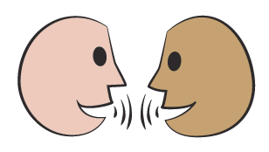
Day 1: Add 1-digit numbers to 3-digit numbers.
347 + 5
Think, pair, share – What different strategies could you use to find 347 + 5?
We could just count on 5 from 347… 348, 349, 350, 351, 352, but is there a better way?
We could use number facts:
7 + 5 = 12 so 347 + 5 = 352.
Can you see why?
We could ‘bridge the 10’, adding 5 in two steps:
347 + 3 + 2 = ?
Notes:
Further teaching with Y3

Slide 17
Day 1: Add 1-digit numbers to 3-digit numbers.
Discuss how you can solve these two questions without counting on in 1s.
236 + 7 and 878 + 6
Let’s check 236 + 7
Let’s check 878 + 6
We could use number facts:
8 + 6 = 14 so 878 + 6 = 884
Can you see why?
We could ‘bridge the 10’, adding 7 in two steps:
236 + 4 + 3 = ?
We could use number facts:
6 + 7 = 13 so 236 + 7 = 243, can you see why?
We could ‘bridge the 10’, adding 6 in two steps:
878 + 2 + 4 = ?

Slide 18
Day 1: Add 1-digit numbers to 3-digit numbers.
Discuss how you can solve these two questions without counting on in 1s.
This time we cross a 100s number…!
397 + 5 and 693 + 9
Let’s check 397 + 5
Let’s check 693 + 9
We could ‘bridge 100’, adding 9 in two steps:
693 + 7 + 2 = ?
We could ‘bridge 100’, adding 5 in two steps:
397 + 3 + 2 = ?
We could use number facts:
7 + 5 = 12 so 397 + 5 = 402.
Can you see why?
We could use number facts:
3 + 9 = 12 so 693 + 9 = 702.
Can you see why?
Notes:
Y3 children can now go on to do differentiated GROUP ACTIVITIES. You can find Hamilton’s group activities in this unit’s PLANNING download.
Y3 WT/ARE/GD: Play a card game where 1-digit numbers are added to 3-digit numbers OR a card and dice game.

Slide 19
Challenge
Notes:
The Practice Sheet on this slide is suitable for most Y3 children.
Differentiated PRACTICE WORKSHEETS are available on Hamilton’s website in this unit’s WORKSHEETS box.
Y3 WT/ARE/GD: Adding 1-digit numbers to 3-digit numbers Sheet 3.
Working towards ARE complete Section A and first 4 questions of Section B.
Working at ARE complete at least Sections A and B.
Greater Depth start at Section B.

Slide 20
Addition and Subtraction
Bridging
Objectives
Day 2
Y2: Subtract a 1-digit from a 2-digit number by bridging multiples of 10 using knowledge of pairs to 10 and place value.
Y3: Subtract 1-digit numbers from 3-digit numbers.

Slide 21
Day 2: Subtract a 1-digit from a 2-digit number by bridging multiples of 10 using knowledge of pairs to 10 and place value; Subtract 1-digit numbers from 3-digit numbers.
We are going to subtract 3 beads.
What multiple of 10 do we reach?
30 – 2 = ?
30 – 2 = 28
What number fact will help us to take 2 beads from 30?
33 – 3 = 30
So, 33 – 5 = 28

Slide 22
Day 2: Subtract a 1-digit from a 2-digit number by bridging multiples of 10 using knowledge of pairs to 10 and place value; Subtract 1-digit numbers from 3-digit numbers.
What number fact will help us to take 3 beads from 60?
60 – 3 = ?
60 – 3 = 57
70 – 4 = ?
What number fact will help us to take 4 beads from 70?
70 – 4 = 66

Slide 23
Day 2: Subtract a 1-digit from a 2-digit number by bridging multiples of 10 using knowledge of pairs to 10 and place value; Subtract 1-digit numbers from 3-digit numbers.
50 – 5 = 45
What number fact will help us to take 5 beads from 50?
50 – 5 = ?
See how we used the bonds to 10 each time!

Slide 24
Day 2: Subtract a 1-digit from a 2-digit number by bridging multiples of 10 using knowledge of pairs to 10 and place value; Subtract 1-digit numbers from 3-digit numbers.
We are going to find 34 – 5.
34 – 5 = 29
Draw a label after the 34th bead.
How many do we still need to take away?
How many beads to take away to reach 30?
What is the answer?
Notes:
Ask a child to draw a label after the 34th bead

Slide 25
Day 2: Subtract a 1-digit from a 2-digit number by bridging multiples of 10 using knowledge of pairs to 10 and place value; Subtract 1-digit numbers from 3-digit numbers.
We are going to find 44 – 5.
44 – 5 = 39
Draw a label after the 44th bead.
How many do we still need to take away?
How many beads to take away to reach 40?
What is the answer?
Notes:
Ask a child to draw a label after the 44th bead

Slide 26
Day 2: Subtract a 1-digit from a 2-digit number by bridging multiples of 10 using knowledge of pairs to 10 and place value; Subtract 1-digit numbers from 3-digit numbers.
We are going to find 56 – 7.
56 – 7 = 49
Draw a label after the 56th bead.
How many do we still need to take away?
How many beads to take away to reach 50?
What is the answer?
Notes:
Ask a child to draw a label after the 56th bead.

Slide 27
Day 2: Subtract a 1-digit from a 2-digit number by bridging multiples of 10 using knowledge of pairs to 10 and place value; Subtract 1-digit numbers from 3-digit numbers.
How many do I need to subtract to reach 30?
We are going to find 35 – 6.
35 – 6 = 29
-1
-5
29
35
How many more do I need to subtract?
What is 30 – 1?

Slide 28
Day 2: Subtract a 1-digit from a 2-digit number by bridging multiples of 10 using knowledge of pairs to 10 and place value; Subtract 1-digit numbers from 3-digit numbers.
How many do I need to subtract to reach 70?
We are going to find 73 – 6.
73 – 6 = 67
-3
-3
67
73
How many more do I need to subtract?
What is 70 – 3?
Notes:
Today would be a great day to use a problem-solving investigation – Secret number – as the Y2 group activity, which you can find in this unit’s MASTERY box on Hamilton’s website.
Alternatively, Y2 children can now go on to do differentiated GROUP ACTIVITIES. You can find Hamilton’s group activities in this unit’s PLANNING download
Y2 WT/ARE/GD: Children subtract a single-digit from a 2-digit number bridging 10.

Slide 29
Investigation
Use ‘Secret number’ from NRICH: https://nrich.maths.org/5651
Play a calculator game: adapt numbers to ensure bridging 10s.
Notes:
Today would be a great day to use a problem-solving investigation – Secret number – from NRICH as the Y2 group activity.

Slide 30
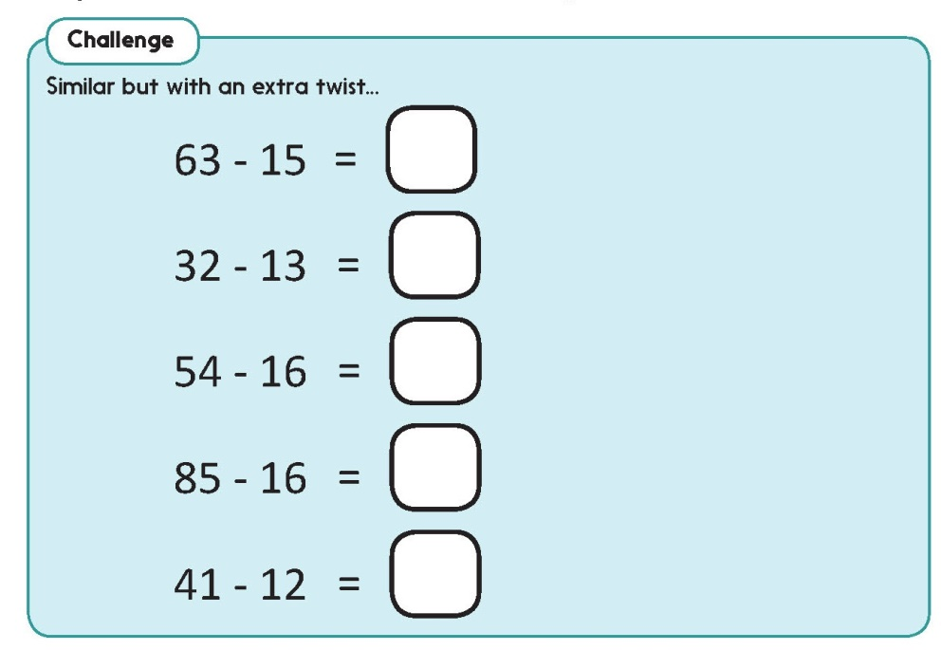
Challenge
Notes:
The Practice Sheet on this slide is suitable for most Y2 children.
Differentiated PRACTICE WORKSHEETS are available on Hamilton’s website in this unit’s WORKSHEETS box.
Y2 WT/ARE/GD: Subtraction Sheet 1
Working towards ARE complete questions 1 to 10.

Slide 31
Day 2: Subtract 1-digit numbers from 3-digit numbers.
Think, pair, share… Is this answer correct? How do you know?
342 - 6 = 336
We could just count back 6 from 342… 341, 340, 339, 338, 337, 336, but is there a better way?
We could use number facts:
12 - 6 = 6 so 342 - 6 = 336. Can you see why?
We could ‘bridge the 10’, subtracting 6 in two steps:
342 - 2 - 4 = ?
Notes:
Further teaching with Y3

Slide 32
Day 2: Subtract 1-digit numbers from 3-digit numbers.
Now try 352 - 7 using each of those strategies.
Let’s check…
We could use number facts:
12 - 7 = 5 so 352 - 7 = 345.
Can you see why?
We could ‘bridge the 10’, subtracting 7 in two steps:
352 - 2 - 5 = ?

Slide 33
Day 2: Subtract 1-digit numbers from 3-digit numbers.
352 - 7 = 345. We can check by using the inverse operation!
Choose the strategy that works best for you rather than count on or back in 1s. Good mathematicians can spot when to use number facts or bridging 10.
What is 345 + 7? We can use one of the strategies for addition we used in the last lesson.
On your whiteboards write two other subtractions that involve crossing a multiple of 10.
Let’s check some of those…
Notes:
Today would be a great day to use a problem-solving investigation – Magical Subtractions – as the Y3 group activity, which you can find in this unit’s MASTERY box on Hamilton’s website.
Alternatively, Y3 children can now go on to do differentiated GROUP ACTIVITIES. You can find Hamilton’s group activities in this unit’s PLANNING download
Y3 WT: Play a mystery subtractions game where 1-digit numbers are subtracted from 3-digit numbers.
Y3 ARE/GD: Play a mystery subtractions game where 1-digit numbers are subtracted from 3-digit numbers OR a card and dice game where 1-digit numbers are subtracted from 3-digit numbers..

Slide 34
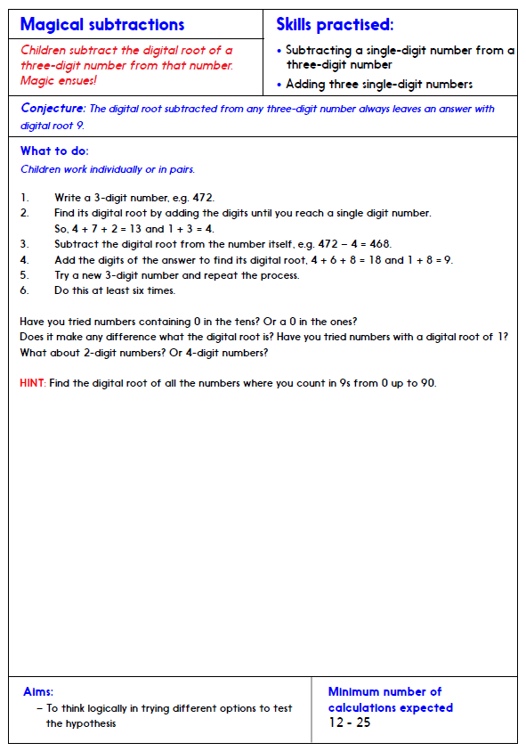
Investigation:
Adult Sheet
Notes:
Today would be a great day to use a problem-solving investigation – Magical subtractions – as the Y3 group activity, which you can find in this unit’s IN-DEPTH INVESTIGATION box on Hamilton’s website.

Slide 35
Investigation:
Child Sheet
Notes:
Today would be a great day to use a problem-solving investigation – Magical subtractions – as the Y3 group activity, which you can find in this unit’s IN-DEPTH INVESTIGATION box on Hamilton’s website.

Slide 36
Challenge
Notes:
The Practice Sheet on this slide is suitable for most Y3 children.
Differentiated PRACTICE WORKSHEETS are available on Hamilton’s website in this unit’s WORKSHEETS box.
Y3 WT/ARE/GD: Subtracting 1-digit numbers from 3-digit numbers Sheet 2.
Working towards ARE complete Section A and first 4 questions of Section B.
Working at ARE complete at least Sections A and B.
Greater Depth start at Section B.

Slide 37
Addition and Subtraction
Bridging
Well Done! You’ve completed this unit.
Objectives
Day 1
Y2: Add a 1-digit number to a 2-digit number by bridging multiples of 10 using knowledge of pairs to 10 and place value.
Y3: Add 1-digit numbers to 3-digit numbers.
Day 2
Y2: Subtract a 1-digit from a 2-digit number by bridging multiples of 10 using knowledge of pairs to 10 and place value.
Y3: Subtract 1-digit numbers from 3-digit numbers.

Slide 39
