Slide 1
Addition and Subtraction
Number bonds to 100
Objectives
Day 1
Add 3 or 4 numbers less than 20, using number facts.
Add 3, 4 or 5 numbers less than 20, using number facts.
Day 2
Know pairs of multiples of 5 that total 100; Find pairs of 2-digit numbers that total 100.
Quickly work out pairs of 2-digit numbers that total 100.
Day 3
Count up to subtract 2-digit numbers from 100; Find change from £1.
Count up to subtract 2-digit numbers from 100; Find change from £1.
Notes:
Before teaching, be aware that:
On Day 2 children will need mini-whiteboards and pens.
On Day 3 children will need mini-whiteboards and pens.

Slide 2
Addition and Subtraction
Number bonds to 100
Short Mental Workouts
Day 1
Pairs to 20 and related subtractions.
Day 2
Complements to multiples of 10, e.g. 57 + □ = 60.
Day 3
Complements to multiples of 10.
Notes:
The short activities suggested here do not have to be done at the beginning of your maths lesson - they are suitable for doing at any time of the day to provide ongoing revision of important mental and oral skills.
While there probably isn’t time during your maths lesson for these activities, it is crucial to regularly revisit the skills used. If you decide to use them – perhaps at the beginning of the day for ‘morning maths’, as you line up for lunch, or as a ‘brain-break’ during the afternoon - it might be useful to drag and drop the relevant slide or slides below to that day’s teaching.

Slide 3
Addition and Subtraction
Number bonds to 100
Short Mental Workout
Pairs to 20 and related subtractions.
Notes:
You can choose to drag this and the following slide to the start of Day 1
Show children the first bar model picture (see next slide). Together, write 4 facts to go with this picture: 17 + 3 = 20, 3 + 17 = 20, 20 – 3 = 17 and 20 – 17 = 3. Children write 4 facts for at least 3 other pictures on their whiteboards.

Slide 5
Addition and Subtraction
Number bonds to 100
Short Mental Workout
Complements to multiples of 10, e.g. 57 + □ = 60.
Notes:
You can choose to drag this and the following slide to the start of Day 2
Show a 100 grid (see next slide). Highlight a number (for instance 57) and ask children to write on their whiteboards what the next multiple of 10 is (60) AND how many more to get there (3). Repeat with other numbers and highlight that children are using number bonds to 10, so 7 + 3 = 10.

Slide 7
Addition and Subtraction
Number bonds to 100
Short Mental Workout
Complements to multiples of 10.
Notes:
You can choose to drag this slide to the start of Day 3
Show 37 on the 100 bead bar, children show digit card with the complement (3) to the next 10 (40). Repeat with other 2-digit numbers, first with the 100 bead bar and then without.

Slide 8
Addition and Subtraction
Number bonds to 100
Objectives
Day 1
Add 3 or 4 numbers less than 20, using number facts.
Add 3, 4 or 5 numbers less than 20, using number facts.

Slide 9
Day 1: Add 3 or 4 numbers less than 20, using number facts; Add 3, 4 or 5 numbers less than 20, using number facts.
3
5
17
4
Talk to your partner. How would you choose to add these 4 numbers?
Clue – can you find a pair that makes 20?
What is 5 + 4?
And what is 20 + 9?

Slide 10
Day 1: Add 3 or 4 numbers less than 20, using number facts; Add 3, 4 or 5 numbers less than 20, using number facts.
2
5
17
5
Talk to your partner – how would you choose to add these 4 numbers?
Clue – did you spot the double?
What is 17 + 2?
And what is 19 + 10?

Slide 11
Day 1: Add 3 or 4 numbers less than 20, using number facts; Add 3, 4 or 5 numbers less than 20, using number facts.
8
10
8
4
Talk to your partner – what about these 4 numbers?
I remembered 8 and 8 are 16.
I know 16 and 4 total 20.
We can find 20 add 10, no problem…
Has anyone found a different way? That’s OK as long as it’s efficient and we get the right answer!

Slide 12
Day 1: Add 3 or 4 numbers less than 20, using number facts; Add 3, 4 or 5 numbers less than 20, using number facts.
4
8
10
6
Talk to your partner – what about these 4 numbers?
I know 6 and 4 make 10.
I know 10 and 10 make 20.
20 add 8 is a place value addition…
We can make additions more straightforward to complete by spotting ‘known facts’ including number bonds and doubles, and/or putting the larger numbers first then counting on.
Notes:
Today would be a great day to use a problem-solving investigation – Puzzling Squares– as the group activity, which you can find in this unit’s IN-DEPTH INVESTIGATION box on Hamilton’s website.
Alternatively, children can now go on to do differentiated GROUP ACTIVITIES. You can find Hamilton’s group activities in this unit’s TEACHING AND GROUP ACTIVITIES download.
Y3 WT: Mystery number bags – adding 3 or more numbers.
Y3 ARE/GD: Play ‘tiddlywinks’ to generate 3 or more numbers to add.
Y4 WT/ARE/GD: Play ‘tiddlywinks’ to generate 3 or more numbers to add.

Slide 13
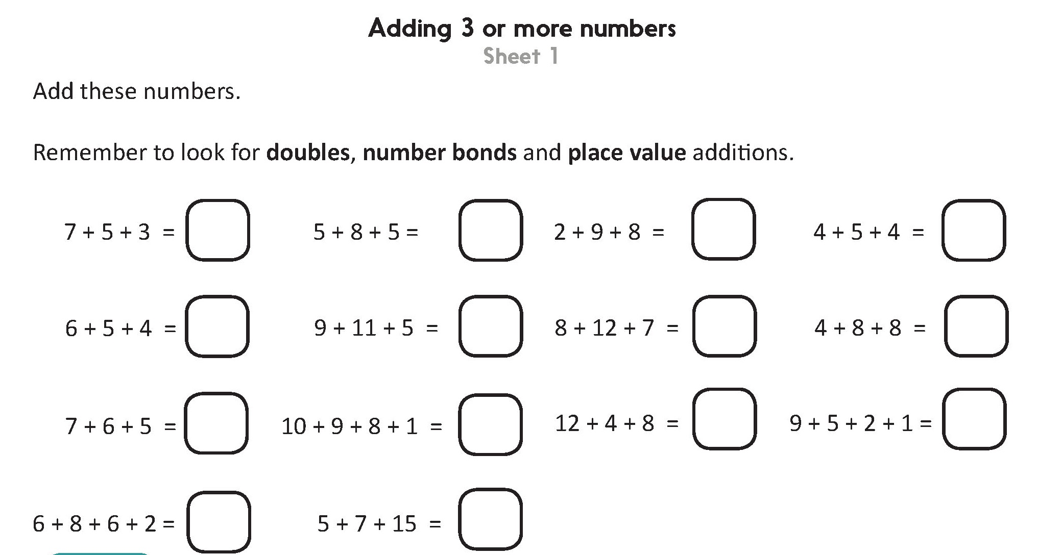
Challenge
Notes:
The Practice Sheet on this slide is suitable for most Y3 children.
Differentiated PRACTICE WORKSHEETS are available on Hamilton’s website in this unit’s PROCEDURAL FLUENCY box.
WT/ARE: Adding 3 or more numbers Sheet 1.
GD: Adding 4 or more numbers Sheet 2.

Slide 14
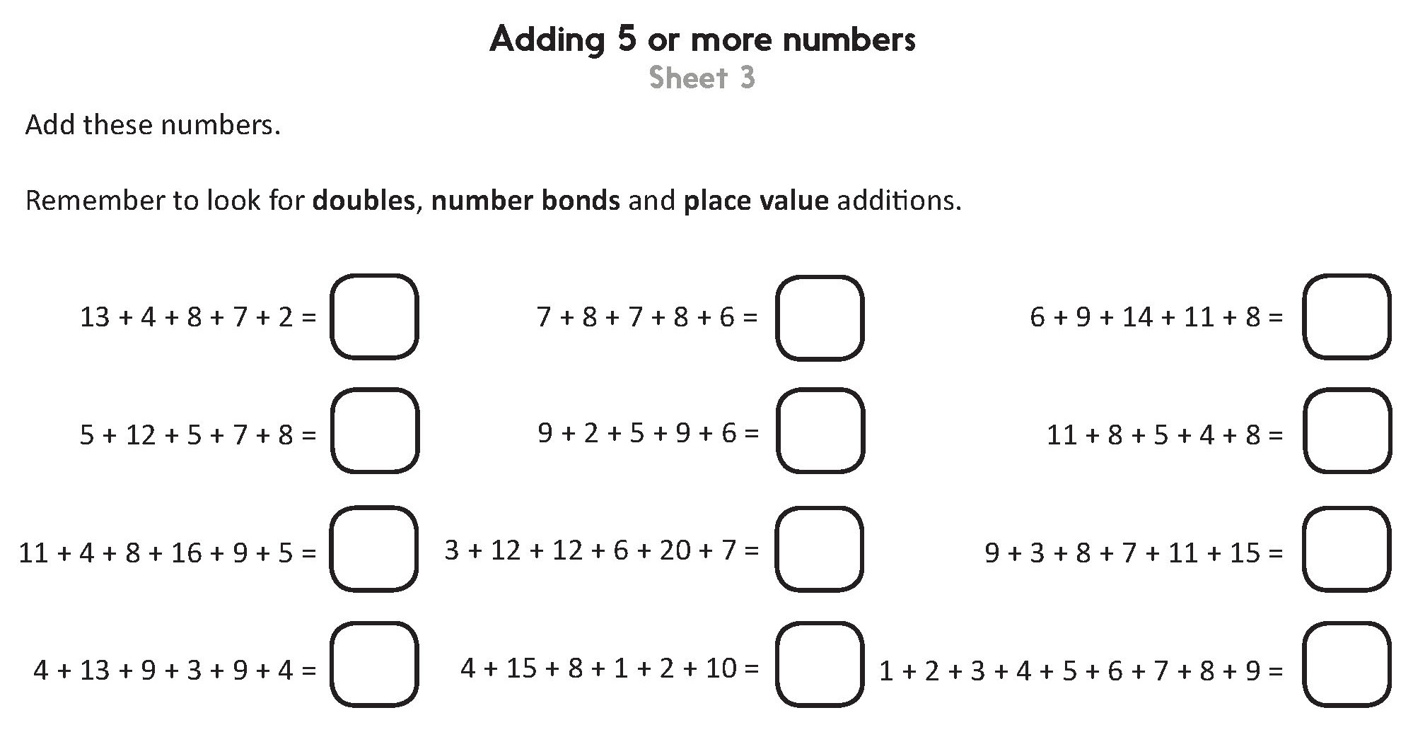
Challenge
Notes:
The Practice Sheet on this slide is suitable for most Y4 children.
Differentiated PRACTICE WORKSHEETS are available on Hamilton’s website in this unit’s PROCEDURAL FLUENCY box.
WT/ARE: Adding 4 or more numbers Sheet 2 or Adding 5 or more numbers Sheet 3.
GD: Adding 5 or more numbers Sheet 3.

Slide 15
Addition and Subtraction
Number bonds to 100
Objectives
Day 2
Know pairs of multiples of 5 that total 100; Find pairs of 2-digit numbers that total 100.
Quickly work out pairs of 2-digit numbers that total 100.

Slide 16
Day 2: Know pairs of multiples of 5 that total 100; Find pairs of 2-digit numbers that total 100; Quickly work out pairs of 2-digit numbers that total 100.
75
How many beads on the bead bar?
Talk to your partner. How many beads are hidden under the cloth?
How many are showing now?

Slide 17
Day 2: Know pairs of multiples of 5 that total 100; Find pairs of 2-digit numbers that total 100; Quickly work out pairs of 2-digit numbers that total 100.
+5
+20
75
How many from 75 to 80?
What do we add to 80 to make 100?
So, 75 + 25 = 100.

Slide 18
Day 2: Know pairs of multiples of 5 that total 100; Find pairs of 2-digit numbers that total 100; Quickly work out pairs of 2-digit numbers that total 100.
Talk to your partner.
How many beads can you see and how many are hidden under the cloth?

Slide 19
Day 2: Know pairs of multiples of 5 that total 100; Find pairs of 2-digit numbers that total 100; Quickly work out pairs of 2-digit numbers that total 100.
+5
+30
65
First mark on 65…
Then 30 to 100.
We can show this on a number line.
Jump 5 to 70…
65 + ? = 100

Slide 20
Day 2: Know pairs of multiples of 5 that total 100; Find pairs of 2-digit numbers that total 100; Quickly work out pairs of 2-digit numbers that total 100.
Talk to your partner. If you could see 85 beads how many would be hidden? What if you could see 25?
You can always use a number line to check...

Slide 21
Day 2: Know pairs of multiples of 5 that total 100; Find pairs of 2-digit numbers that total 100; Quickly work out pairs of 2-digit numbers that total 100.
How many to the next multiple of 10?
How many beads am I showing?
How many more to 100?
+ 3
+ 30
67
67 + ? = 100

Slide 22
Day 2: Know pairs of multiples of 5 that total 100; Find pairs of 2-digit numbers that total 100; Quickly work out pairs of 2-digit numbers that total 100.
89 + ? = 100
89
How many beads are showing?
Let’s check with the beads.
89 + 1 = 90
90 + 10 = 100
Talk to your partner. How many beads are under the cloth? What do we need to add to 89 make 100?

Slide 23
Day 2: Know pairs of multiples of 5 that total 100; Find pairs of 2-digit numbers that total 100; Quickly work out pairs of 2-digit numbers that total 100.
+ 8
+ 20
72
What do we have to add to 72 to make 100?
First jump to the next multiple of 10.
Then jump 20 to 100.
72 + ? = 100

Slide 24
Day 2: Know pairs of multiples of 5 that total 100; Find pairs of 2-digit numbers that total 100; Quickly work out pairs of 2-digit numbers that total 100.
+ 4
+ 40
56
What do we have to add to 56 to make 100?
First jump to the next multiple of 10.
Then jump 40 to 100.
56 + ? = 100
Notes:
Children can now go on to do differentiated GROUP ACTIVITIES. You can find Hamilton’s group activities in this unit’s TEACHING AND GROUP ACTIVITIES download.
Y3 WT: Pairs to 100 bar model game: finding pairs of multiples of 5 that total 100.
Y3 ARE/GD: Split a 100 bead string to find pairs to 100.
Y4 WT/ARE/GD: Play ‘Four in a row’, finding complements to 100.

Slide 25
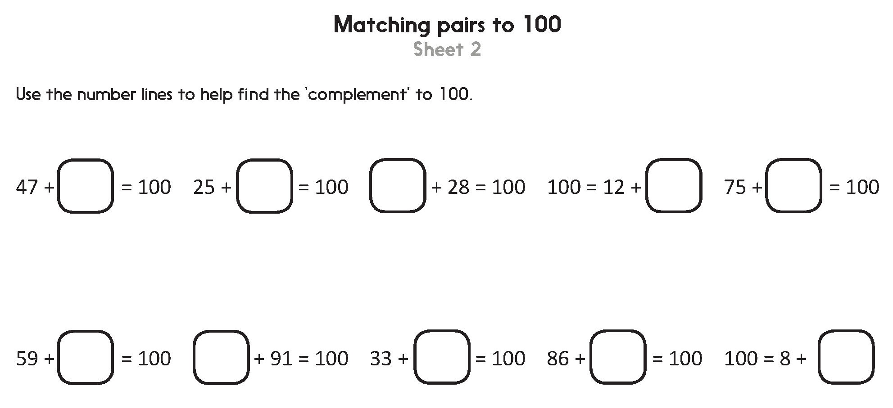
Challenge
Notes:
The Practice Sheet on this slide is suitable for most Y3 children.
Differentiated PRACTICE WORKSHEETS are available on Hamilton’s website in this unit’s PROCEDURAL FLUENCY box.
WT: Multiples of 5: pairs to 100 Sheet 1.
ARE/GD: Matching pairs to 100 Sheet 2.

Slide 26
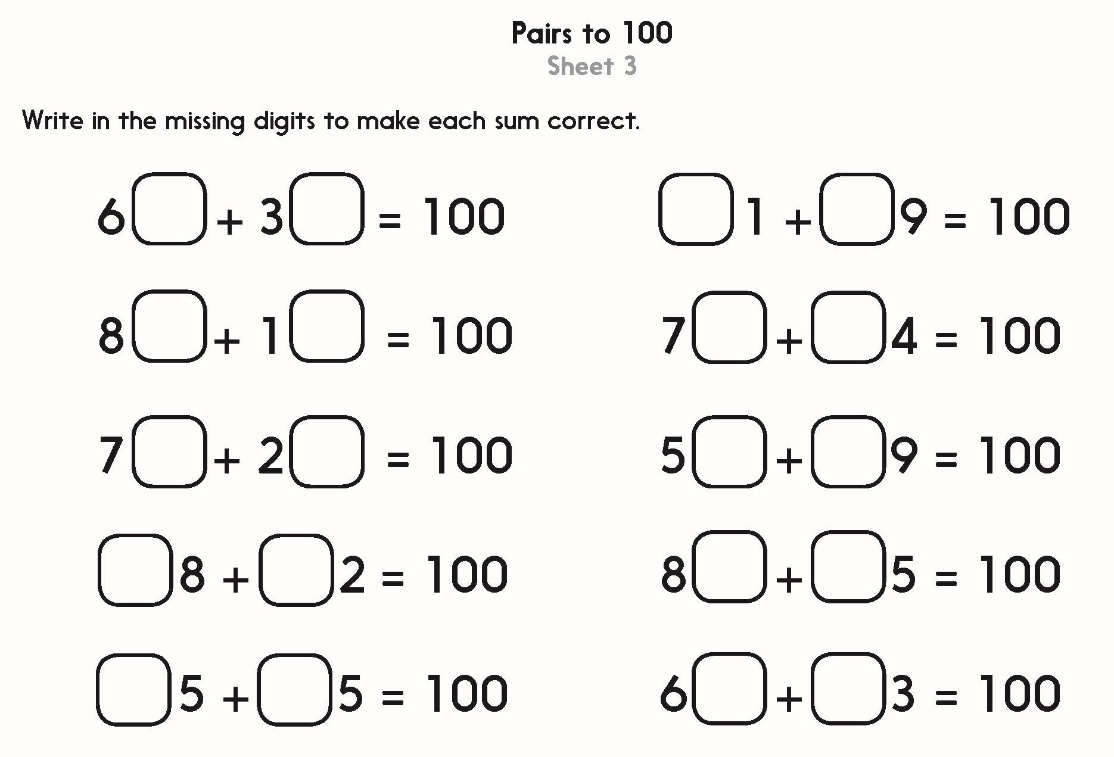
Notes:
The Practice Sheet on this slide is suitable for most Y4 children.
Differentiated PRACTICE WORKSHEETS are available on Hamilton’s website in this unit’s PROCEDURAL FLUENCY box.
WT/ARE/GD: Pairs to 100 Sheet 3.

Slide 27
Addition and Subtraction
Number bonds to 100
Objectives
Day 3
Count up to subtract 2-digit numbers from 100; Find change from £1.
Count up to subtract 2-digit numbers from 100; Find change from £1.

Slide 28
Day 3: Count up to subtract 2-digit numbers from 100; Find change from £1; Count up to subtract 2-digit numbers from 100; Find change from £1.
+ 5
+ 10
85
How can we solve 100 - 85
on the number line?
First mark on 85.
Jump 5 to 90.
Then 10 to 100.
100 - 85 = ?

Slide 29
Day 3: Count up to subtract 2-digit numbers from 100; Find change from £1; Count up to subtract 2-digit numbers from 100; Find change from £1.
Talk to your partner…
For these questions, is it more efficient to count up to the nearest 10 and then 100 OR can you spot the number bonds to do one big hop to 100?
Use number bonds when you know them.
What is 85 + 15?
So what is 100 - 85 ?
100 - 75
100 - 65
100 - 78
100 - 57

Slide 30
Day 3: Count up to subtract 2-digit numbers from 100; Find change from £1; Count up to subtract 2-digit numbers from 100; Find change from £1.
100
82
Talk to your partner…
For this bar model how could you find the missing number?

Slide 31
Day 3: Count up to subtract 2-digit numbers from 100; Find change from £1; Count up to subtract 2-digit numbers from 100; Find change from £1.
There are 100p in £1 so we can use what we’ve been learning to find change from £1!

Slide 32
Day 3: Count up to subtract 2-digit numbers from 100; Find change from £1; Count up to subtract 2-digit numbers from 100; Find change from £1.
If you buy this badge how much change will you get from £1?
2p
20p
78p
80p
£1
Then 20p to £1.
So the change
is 22p.
Draw a line and mark on 78p and £1.
Jump 2p to 80p.

Slide 33
Day 3: Count up to subtract 2-digit numbers from 100; Find change from £1; Count up to subtract 2-digit numbers from 100; Find change from £1.
If you buy this badge how much change will you get from £1?
4p
70p
26p
30p
£1
Draw a line and mark on 26p and £1.
Then 70p to £1.
So the change
is 74p.
Jump 4p to 30p.
Notes:
Children can now go on to do differentiated GROUP ACTIVITIES. You can find Hamilton’s group activities in this unit’s TEACHING AND GROUP ACTIVITIES download.
Y3 WT: Use bar models to create subtractions which require Frog to help us find the change from £1.
Y3 ARE/GD: Pick a badge activity - finding change from £1.
Y4 WT/ARE/GD: Make 2-digit numbers and find the complement to 100, while playing a game on a 1 to 100 grid.

Slide 34
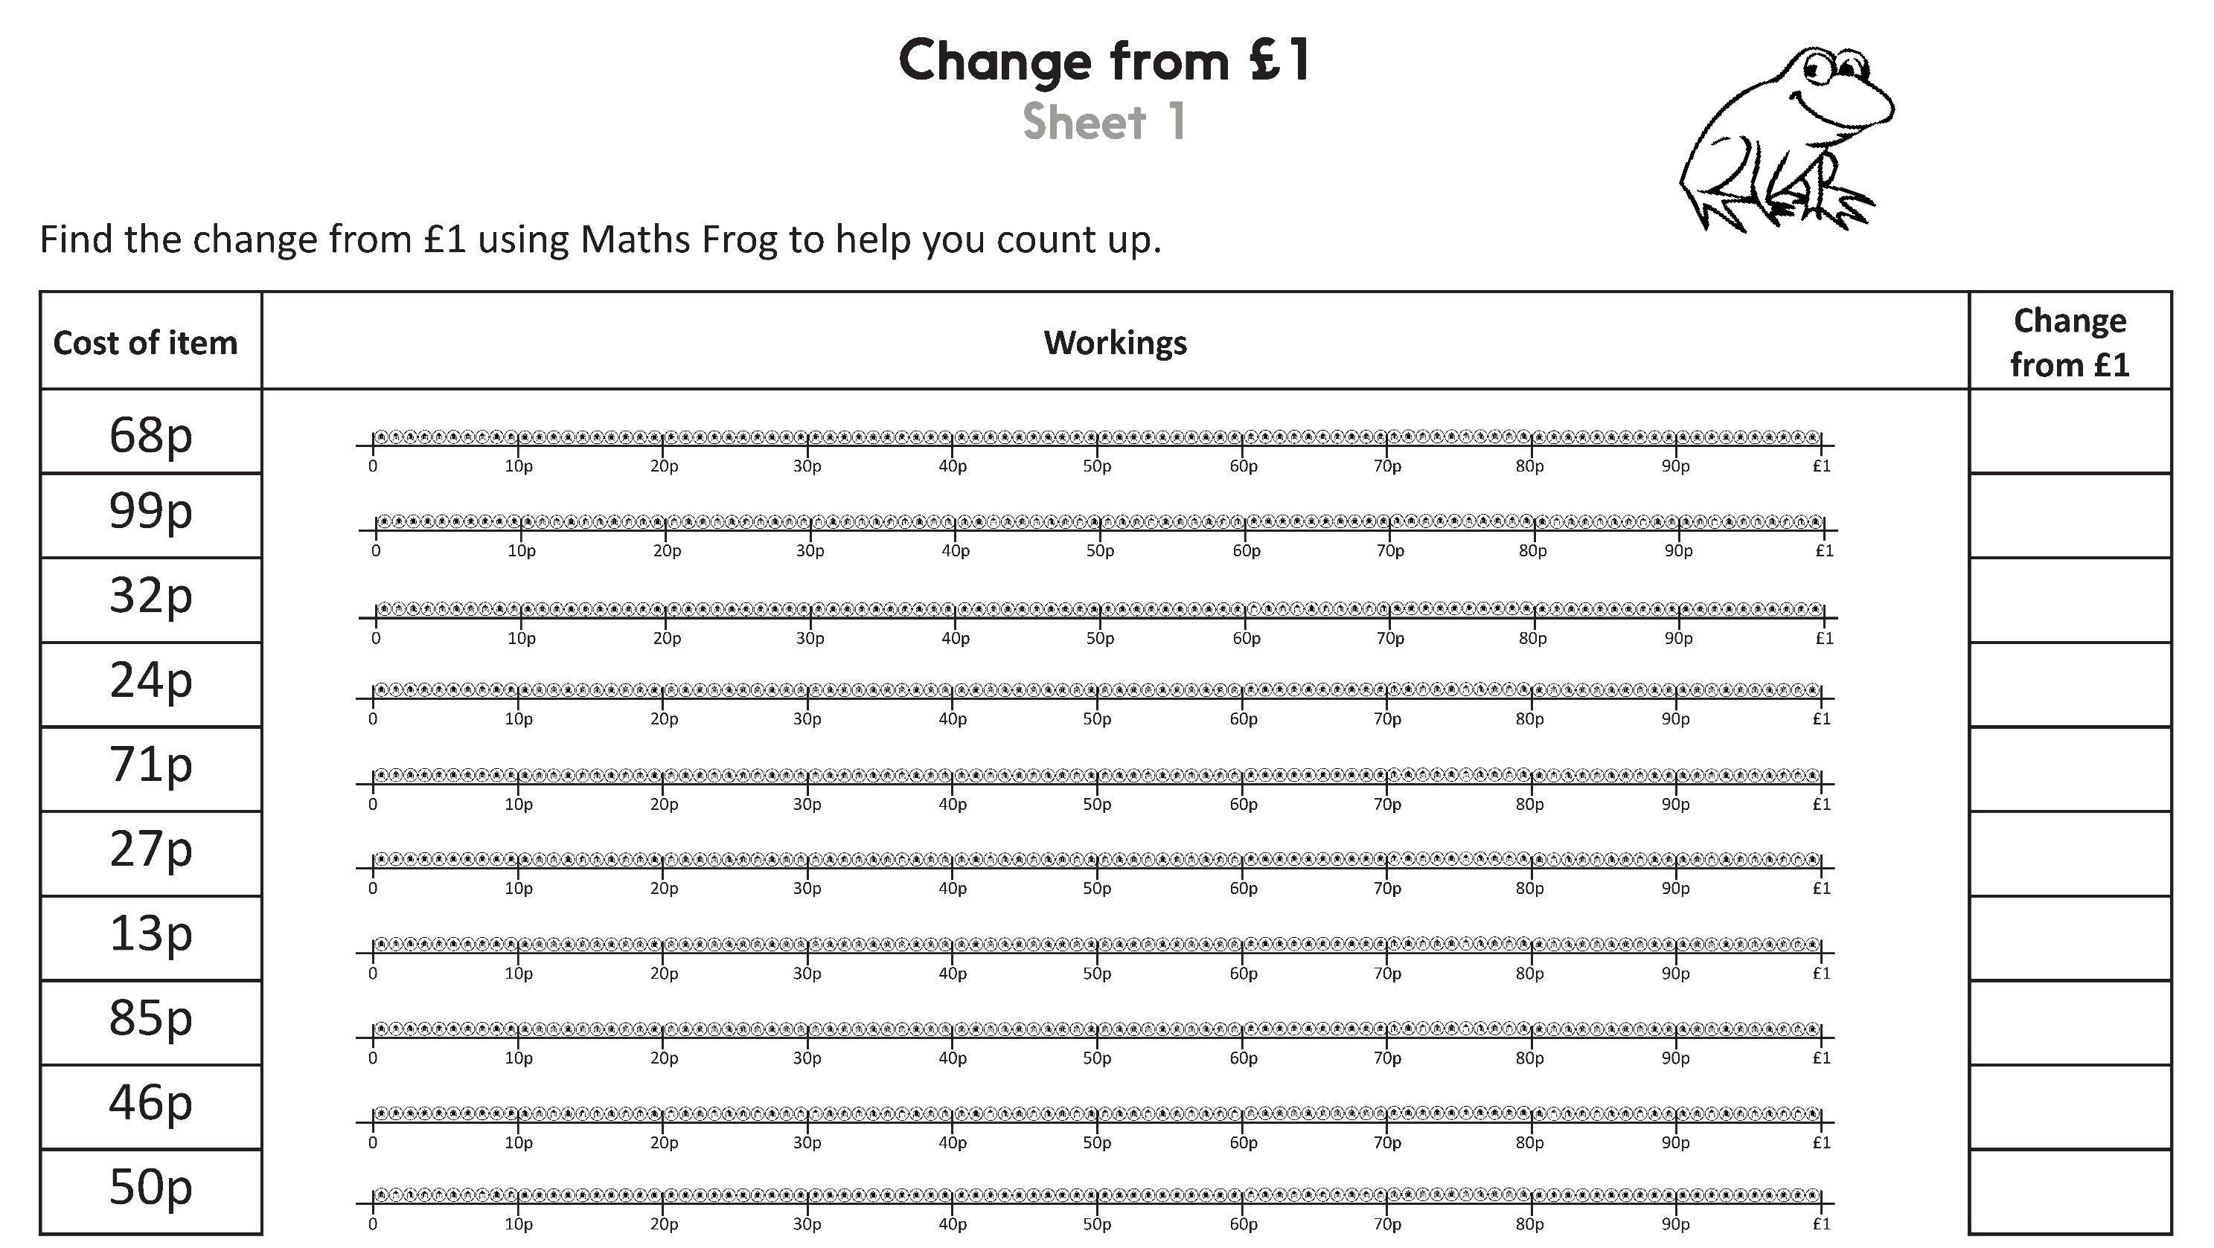
Challenge
Notes:
The Practice Sheet on this slide is suitable for most Y3 children.
Differentiated PRACTICE WORKSHEETS are available on Hamilton’s website in this unit’s PROCEDURAL FLUENCY box.
WT/ARE/GD: Change from £1 Sheet 1.

Slide 35
Challenge
Notes:
The Practice Sheet on this slide is suitable for most Y4 children.
Differentiated PRACTICE WORKSHEETS are available on Hamilton’s website in this unit’s PROCEDURAL FLUENCY box.
WT/ARE/GD: Subtracting from 100 Sheet 2.

Slide 36
Addition and Subtraction
Number bonds to 100
Well Done! You’ve completed this unit.
Objectives
Day 1
Add 3 or 4 numbers less than 20, using number facts.
Add 3, 4 or 5 numbers less than 20, using number facts.
Day 2
Know pairs of multiples of 5 that total 100; Find pairs of 2-digit numbers that total 100.
Quickly work out pairs of 2-digit numbers that total 100.
Day 3
Count up to subtract 2-digit numbers from 100; Find change from £1.
Count up to subtract 2-digit numbers from 100; Find change from £1.
Notes:
You can now use the Mastery: Reasoning and Problem-Solving questions to assess children’s success across this unit. Go to the next slides.

Slide 37
Problem solving and reasoning questions
Year 3
What number pairs or facts can you spot to add these strings of numbers:
7 + 4 + 7 = □
1 + 5 + 9 + 5 = □
□ = 8 + 7 + 5
14 + 3 + 3 = □
Find the missing numbers:
□ + 35 = 100
48 + □ = 100
100 = □ + 27
How much change does Ally get from £1 if she spends:
93p, 59p, 17p, 64p?

Slide 38
Problem solving and reasoning answers
Year 3
What number pairs or facts can you spot to add these strings of numbers:
7 + 4 + 7 = 18 double 7
1 + 5 + 9 + 5 = 20 pairs to 10
20 = 8 + 7 + 5 near double and bonds to 20
14 + 3 + 3 = 20 double 3 and bonds to 20
Find the missing numbers:
65 + 35 = 100
48 + 52 = 100
100 = 73 + 27 Answers of 75, 62 and 83 suggest children are ignoring the extra 10 from adding the 1s.
How much change does Ally get from £1 if she spends:
93p, 59p, 17p, 64p? 7p, 41p, 83p and 36p respectively.
Answers of 51p, 93p and 46p for the latter 3 questions suggest the same errors with complements to 100 as noted in the previous question.

Slide 39
Problem solving and reasoning questions
Year 4
What number pairs or facts can you spot to add these strings of numbers:
6 + 7 + 4 + 7 = □
11 + 5 + 9 + 5 = □
□ = 8 + 17 + 5
14 + 3 + 3 + 6 + 6 = □
Find the missing numbers:
□ + 32 = 100
27 + □ = 100
100 = □ + 74
Each week, Anna spends a different amount from her £1 pocket money.
Week 1: 59p
Week 2: 83p
Week 3: 97p How much change did she receive in total?

Slide 40
Problem solving and reasoning answers
Year 4
What number pairs or facts can you spot to add these strings of numbers:
6 + 7 + 4 + 7 = 24 double 7, pairs to 10
11 + 5 + 9 + 5 = 30 pairs to 10 and 20
30 = 8 + 17 + 5 complements of 30 (13 and 17)
14 + 3 + 3 + 6 + 6 = 32 doubles
Find the missing numbers:
68 + 32 = 100 27 + 73 = 100 100 = 26 + 74
Each week, Anna spends a different amount from her £1 pocket money.
Week 1: 59p change 41p
Week 2: 83p change 17p
Week 3: 97p change 3p
How much change did she receive in total? 61p

