Slide 1
Addition and Subtraction
Counting up subtraction (Frog)
Objectives
Day 1
Use ‘Frog’ (counting up) to subtract pairs of 2-digit numbers (answers <20).
Use ‘Frog’ (counting up) to subtract pairs of 2-digit numbers (answers >20).
Day 2
Use ‘Frog’ (counting up) to subtract pairs of 2-digit numbers (answers <30).
Subtract 2-digit numbers from numbers >100. Explore use of counting up and counting back, discussing choice of method.
Day 3
Use counting up (Frog) to subtract numbers either side of 100, e.g. 102 - 86.
Use counting up (Frog) to subtract numbers either side of a multiple of 100, e.g. 402 - 356.
Day 4
Use counting up (Frog) to subtract numbers either side of 100, e.g. 112 - 86.
Use counting up (Frog) to subtract numbers either side of a multiple of 100, e.g. 432 - 356; Check subtraction with addition.
Notes:
Before teaching, be aware that:
On Day 1 children will need mini-whiteboards and pens. ??
On Day 2 children will need mini-whiteboards and pens. ??
On Day 3 children will need mini-whiteboards and pens. ??
On Day 4 children will need mini-whiteboards and pens. ??

Slide 2
Addition and Subtraction
Counting up subtraction (Frog)
Short Mental Workouts
Day 1
Bonds to 20.
Day 2
Add three 1-digit numbers.
Day 3
Complements to 100.
Day 4
Change from £1.
Notes:
The short activities suggested here do not have to be done at the beginning of your maths lesson - they are suitable for doing at any time of the day to provide ongoing revision of important mental and oral skills.
While there probably isn’t time during your maths lesson for these activities, it is crucial to regularly revisit the skills used. If you decide to use them – perhaps at the beginning of the day for ‘morning maths’, as you line up for lunch, or as a ‘brain-break’ during the afternoon - it might be useful to drag and drop the relevant slide or slides below to that day’s teaching.

Slide 3
Addition and Subtraction
Counting up subtraction (Frog)
Short Mental Workout
Bonds to 20.
Notes:
To use this activity, drag this slide to the start of Day 1
Play ‘Ping-Pong’. Teacher ‘pings’ a number less than 20, the class ‘pong’ back the complement to 20. Occasionally say ‘Ping’, to which the children reply ‘Pong’ (or vice versa!).

Slide 4
Addition and Subtraction
Counting up subtraction (Frog)
Short Mental Workout
Add three 1-digit numbers.
Notes:
To use this activity, drag this slide to the start of Day 2
Give number fans to three children. Ask them each to select a single digit, keeping it hidden until you ask them to show the rest of the class. On your instruction, the three children show their numbers and everyone else finds the total, using number facts to help, writing their answer on their whiteboard. As fluency improves, include a fourth number fan, so that children are adding four 1-digit numbers together.

Slide 5
Addition and Subtraction
Counting up subtraction (Frog)
Short Mental Workout
Complements to 100.
Notes:
To use this activity, drag this slide to the start of Day 3
Show children the bead bar and use a cloth to cover 14 of the beads. Ask children how many beads they can see (86), and then to work out how many you have hidden. Model finding the complement to the nearest 10 (from 86 you count up 4 to get to 90) and then counting up in 10s to get to 100. Repeat with other complements to 100. Children write the answers on their whiteboards.

Slide 6
Addition and Subtraction
Counting up subtraction (Frog)
Short Mental Workout
Change from £1.
Notes:
To use this activity, drag this and the following slide to the start of Day 4
Show children the 0 - £1 penny line (see next slide). Point to the 87p price-tagged picture. Ask: If I buy this, how much money will I have left from £1? Children need to count up to the next 10p (3p) then to £1 (10p) to find out (if confident with bonds to 100, some may be able to do this in one step). With your finger, model the hops that ‘Frog’ would do to find the change. Repeat for the other toys. Which toy would leave you with most change? And the least?

Slide 7
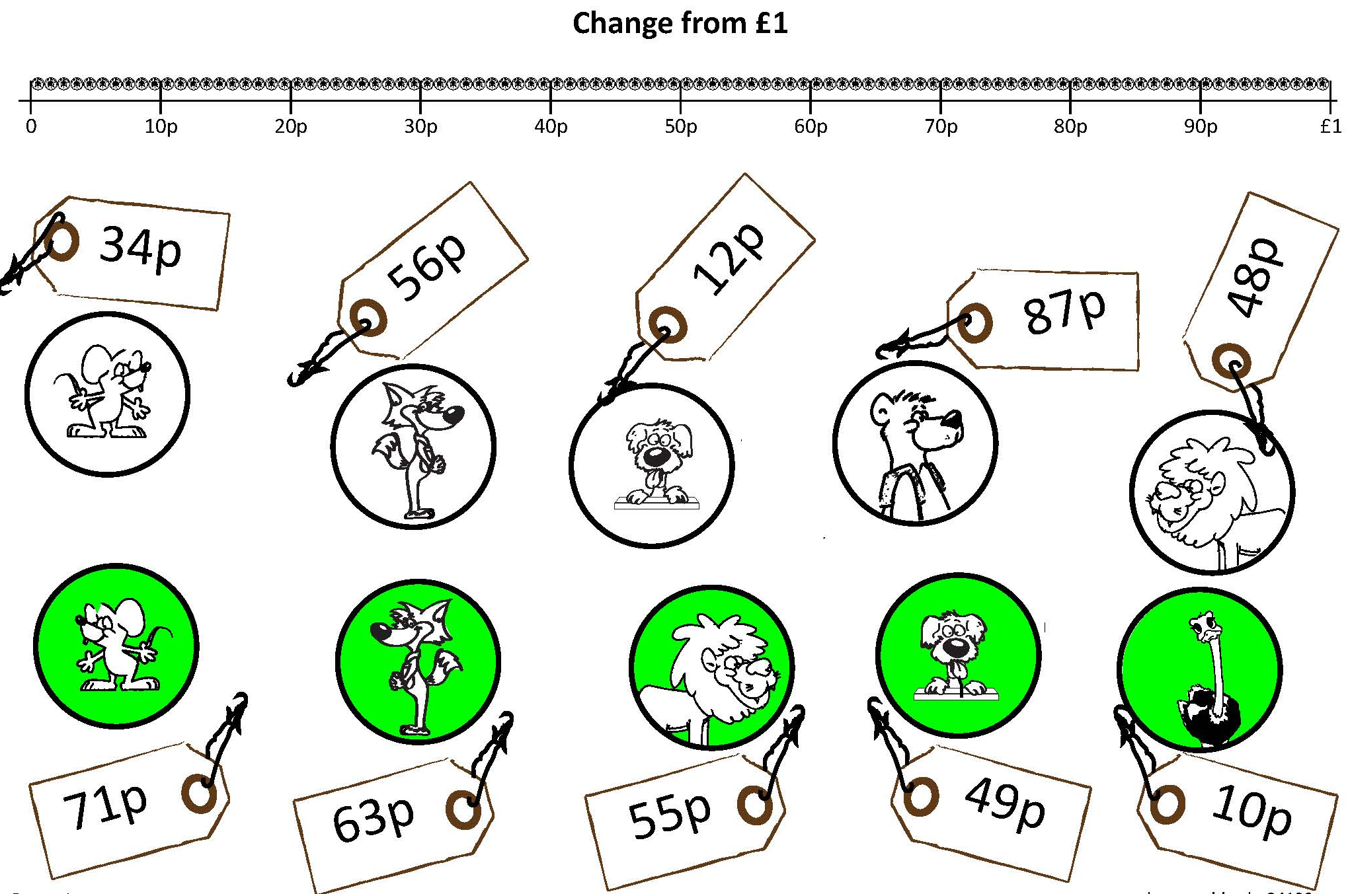

Slide 8
Addition and Subtraction
Counting up subtraction (Frog)
Objectives
Day 1
Use ‘Frog’ (counting up) to subtract pairs of 2-digit numbers (answers less than 20).
Use ‘Frog’ (counting up) to subtract pairs of 2-digit numbers (answers greater than 20).

Slide 9
Day 1: Use ‘Frog’ (counting up) to subtract pairs of 2-digit numbers (answers less than 20); Use ‘Frog’ (counting up) to subtract pairs of 2-digit numbers (answers greater than 20).
Let’s see how he finds the difference between 70 and 56.
So 70 - 56 = 14, can you see why?
He always jumps to ‘friendly’ numbers, like the next multiple of 10 or 100. He knows where he starts and where he is going to finish. We add his jumps to find the difference.
Maths Frog helps us find the difference between two numbers.
4
10
56
60
70
He hops 4 to 60…
… and then 10 to 70.

Slide 10
Day 1: Use ‘Frog’ (counting up) to subtract pairs of 2-digit numbers (answers less than 20); Use ‘Frog’ (counting up) to subtract pairs of 2-digit numbers (answers greater than 20).
So 72 - 54 = 18
Can you see why?
How will Frog count up to find
72 - 54?
Frog hops 6 to 60…
… and then 10 to 70...
… finally 2 to 72.
6
10
2
54
60
70
72

Slide 11
Day 1: Use ‘Frog’ (counting up) to subtract pairs of 2-digit numbers (answers less than 20); Use ‘Frog’ (counting up) to subtract pairs of 2-digit numbers (answers greater than 20).
Let’s try some examples on our whiteboards.
Y3: try 70 - 58 and 72 - 57.
Y4: try 72 - 47 and 65 - 38.

Slide 12
Day 1: Use ‘Frog’ (counting up) to subtract pairs of 2-digit numbers (answers less than 20); Use ‘Frog’ (counting up) to subtract pairs of 2-digit numbers (answers greater than 20).
Let’s write some rules for Maths Frog.
Frog jumps on a number line, to find differences.
Frog starts at the smaller number, then jumps up to the bigger number.
We add up his jumps to find the answer to a subtraction.
He first jumps to the next 10.
Notes:
Children can now go on to do differentiated GROUP ACTIVITIES. You can find Hamilton’s group activities in this unit’s TEACHING AND GROUP ACTIVITIES download.
Y3 WT/ARE/GD: Frog pairs game subtracting two 2-digit numbers.
Y4 Y3 WT/ARE/GD: Frog investigation: think of a 2-digit number, 1st digit greater than 2nd, reverse and subtract, e.g. 85 – 58.

Slide 13
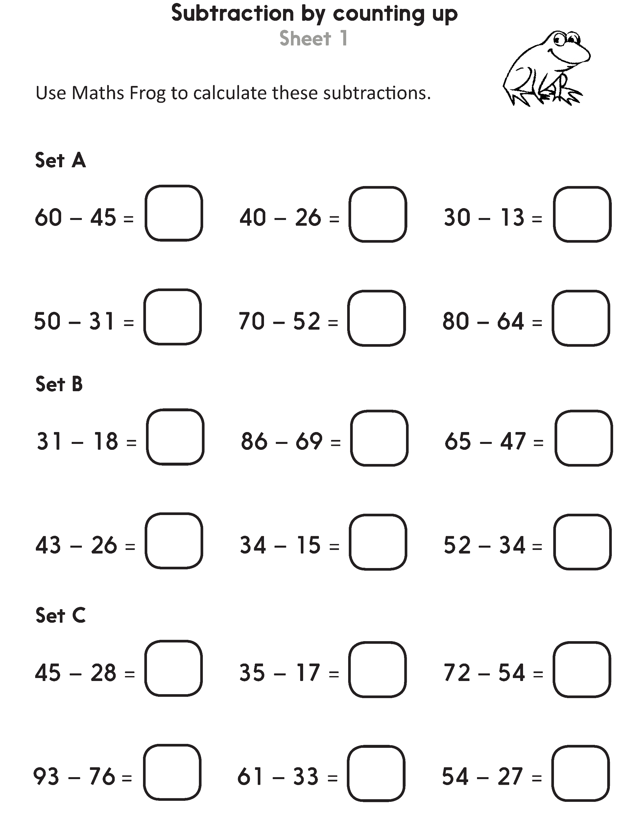
Challenge
Notes:
The Practice Sheet on this slide is suitable for most Y3 children.
Differentiated PRACTICE WORKSHEETS are available on Hamilton’s website in this unit’s PROCEDURAL FLUENCY box.
WT/ARE/GD: Subtraction by counting up Sheet 1.
Working towards ARE do section A and try some of section B, using landmarked lines to help.
Working at ARE complete sections A and B, drawing their own empty number line jottings.
Greater Depth complete sections B and C.

Slide 14
Challenge
Notes:
The Practice Sheet on this slide is suitable for most Y4 children.
Differentiated PRACTICE WORKSHEETS are available on Hamilton’s website in this unit’s PROCEDURAL FLUENCY box.
WT: Counting up to subtract Sheet 2.
ARE/GD: Counting up to subtract Sheet 3.

Slide 15
Addition and Subtraction
Counting up subtraction (Frog)
Objectives
Day 2
Use ‘Frog’ (counting up) to subtract pairs of 2-digit numbers (answers less than 30).
Subtract 2-digit numbers from numbers >100. Explore use of counting up and counting back, discussing choice of method.

Slide 16
Day 2: Use ‘Frog’ (counting up) to subtract pairs of 2-digit numbers (answers less than 30); Subtract 2-digit numbers from numbers >100. Explore use of counting up and counting back, discussing choice of method.
Who can remember our rules for Maths Frog?
Frog jumps on a number line, to find differences.
Frog starts at the smaller number, then jumps up to the bigger number.
We add up his jumps to find the answer to a subtraction.
He first jumps to the next 10.

Slide 17
Day 2: Use ‘Frog’ (counting up) to subtract pairs of 2-digit numbers (answers less than 30); Subtract 2-digit numbers from numbers >100. Explore use of counting up and counting back, discussing choice of method.
Let’s try our rules
to find 65 - 47.
65 - 47 = 18, can you see why?
Frog starts at the smaller number and hops 3 to the next 10.
… and then jumps 10 to 60...
… then 5 to 65.
3
10
5
47
50
60
65

Slide 18
Day 2: Use ‘Frog’ (counting up) to subtract pairs of 2-digit numbers (answers less than 30); Subtract 2-digit numbers from numbers >100. Explore use of counting up and counting back, discussing choice of method.
Now let’s try 65 - 37.
65 - 37 = 28, can you see why?
… and then a big jump of 20 to 60...
Frog hops 3 to the next 10.
… then 5 to 65.
3
20
5
37
40
60
65

Slide 19
Day 2: Use ‘Frog’ (counting up) to subtract pairs of 2-digit numbers (answers less than 30); Subtract 2-digit numbers from numbers >100. Explore use of counting up and counting back, discussing choice of method.
Add the jumps to find 83 - 47.
Now let’s try
83 - 47.
… and then jumps 30 to 80... That’s a big jump!
Frog hops 3 to 50.
… then 3 to 83.
3
30
3
47
50
80
83
Notes:
Y3 children can now go on to do differentiated GROUP ACTIVITIES. You can find Hamilton’s group activities in this unit’s TEACHING AND GROUP ACTIVITIES download.
Y3 WT/ARE/GD: Explore counting up to subtract pairs of 2-digit numbers <100.

Slide 20
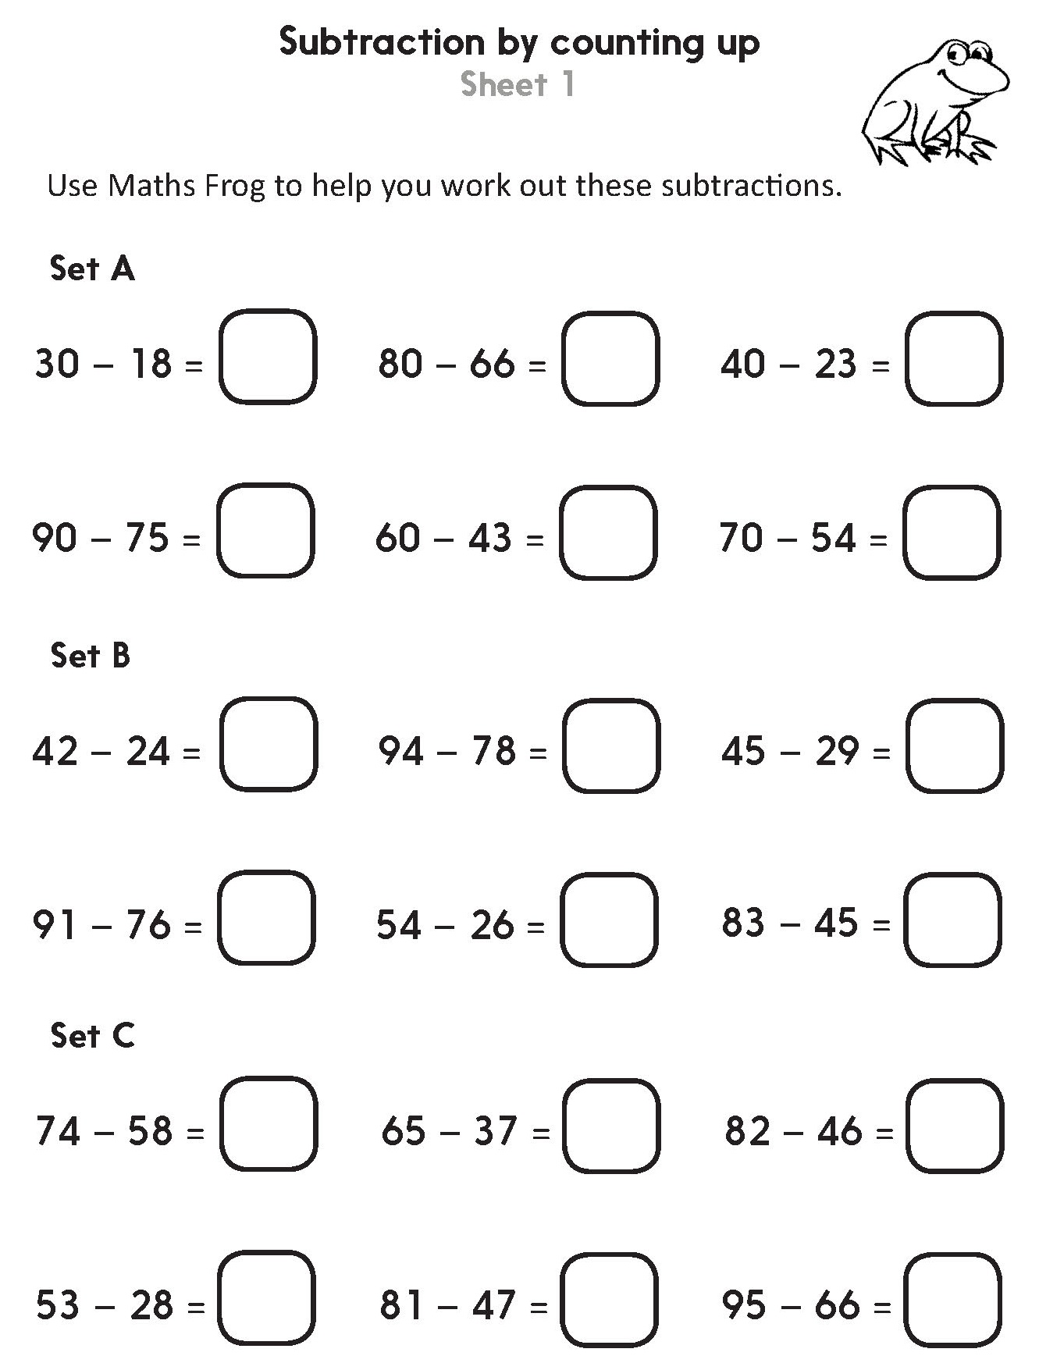
Challenge
Notes:
The Practice Sheet on this slide is suitable for most Y3 children.
Differentiated PRACTICE WORKSHEETS are available on Hamilton’s website in this unit’s PROCEDURAL FLUENCY box.
WT/ARE/GD: Subtraction by counting up Sheet 1.
Working towards ARE complete section A and try some of section B, using landmarked lines to help.
Working at ARE complete section B and try some of C drawing their own empty number line jottings.
Greater Depth complete sections B and C. They may not need to draw jottings.

Slide 21
Day 2: Subtract 2-digit numbers from numbers >100. Explore use of counting up and counting back, discussing choice of method.
123 - 45 = 78
Think-pair-share – how would you solve 123 - 45?
Let’s try with Frog - he’s getting confident!
Add the jumps to find the answer.
50 + 23 + 5 = ?
… and then 50 to 100...
… then 23 to 123.
First 5 to 50…
5
50
23
45
50
100
123
Notes:
Further teaching for Year 4

Slide 22
Day 2: Subtract 2-digit numbers from numbers >100. Explore use of counting up and counting back, discussing choice of method.
Sometimes it can be more efficient to count back. Let’s try for 123 - 45.
…113, 103, 93, 83.
Count back four 10s from 123…
Then 5 more… 82, 81, 80, 79, 78.
The answer is the same! Which way did you prefer…
Notes:
Further teaching for Year 4

Slide 23
Day 2: Subtract 2-digit numbers from numbers >100. Explore use of counting up and counting back, discussing choice of method.
Talk to your partner – For each of these would it be more efficient to count back or to count up using Frog?
123 - 89
123 - 32
123 - 50
It’s OK to disagree!
Notes:
Further teaching for Year 4

Slide 24
Day 2: Subtract 2-digit numbers from numbers >100. Explore use of counting up and counting back, discussing choice of method.
123 - 89 = 34
Let’s try 123 - 89 with Frog…
Add the jumps to find the answer.
23 + 10 + 1 = ?
… and another 10
to 100...
… then 23 to 123.
First hop 1 to 90…
1
10
23
89
90
100
123
Notes:
Further teaching for Year 4

Slide 25
Day 2: Subtract 2-digit numbers from numbers >100. Explore use of counting up and counting back, discussing choice of method.
Let’s try 123 - 32 by counting back.
Count back three 10s from 123…
…113, 103, 93.
Count back 2 more to 91.
Notes:
Y4 children can now go on to do differentiated GROUP ACTIVITIES. You can find Hamilton’s group activities in this unit’s TEACHING AND GROUP ACTIVITIES download.
Y4 WT/ARE/GD: Explore counting up and counting back to subtract 2-digit numbers from numbers >100. Discuss preferences.

Slide 26
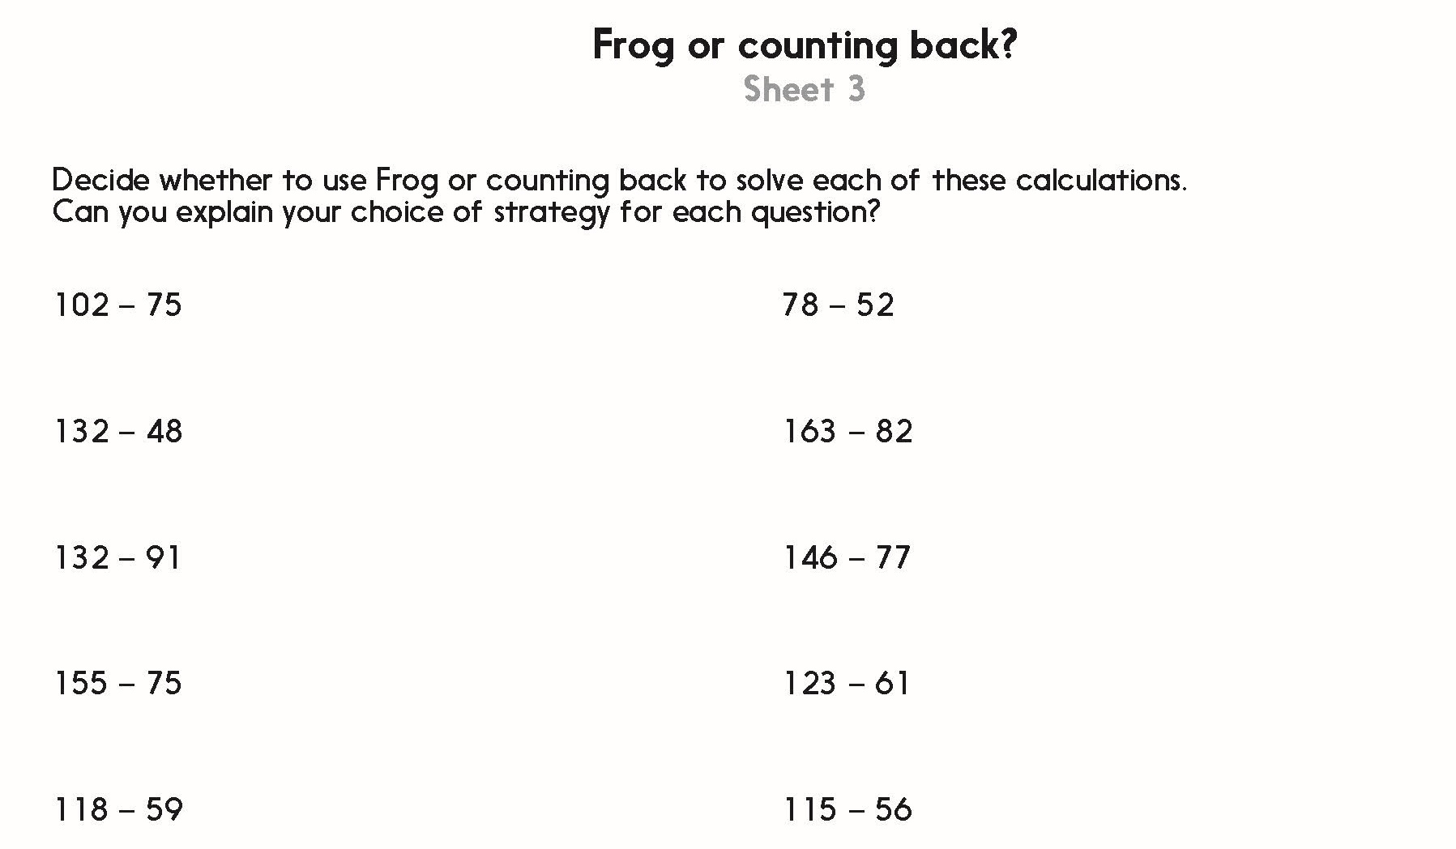
Challenge
Notes:
The Practice Sheet on this slide is suitable for most Y4 children.
Differentiated PRACTICE WORKSHEETS are available on Hamilton’s website in this unit’s PROCEDURAL FLUENCY box.
WT: Frog or counting back? Sheet 2.
ARE/GD: Frog or counting back? Sheet 3.

Slide 27
Addition and Subtraction
Counting up subtraction (Frog)
Objectives
Day 3
Use counting up (Frog) to subtract numbers either side of 100, e.g. 102 - 86.
Use counting up (Frog) to subtract numbers either side of a multiple of 100, e.g. 402 - 356.

Slide 28
Day 3: Use counting up (Frog) to subtract numbers either side of 100, e.g. 102 - 86.
Use counting up (Frog) to subtract numbers either side of a multiple of 100, e.g. 402 - 356.
Let’s see how Frog can cross 100!
Let’s try 102 - 97.
So 102 - 97 = 5
First hops 3 to 100…
… then 2 to 102.
3
2
97
100
102

Slide 29
Day 3: Use counting up (Frog) to subtract numbers either side of 100, e.g. 102 - 86.
Use counting up (Frog) to subtract numbers either side of a multiple of 100, e.g. 402 - 356.
So 102 - 87 = 15
Can you see why?
Sometimes Frog does 3 jumps.
Let’s try 102 - 87.
… then 2 to 102.
First hop 3 to 90…
… and 10 to 100...
3
10
2
87
90
100
102

Slide 30
Day 3: Use counting up (Frog) to subtract numbers either side of 100, e.g. 102 - 86.
Use counting up (Frog) to subtract numbers either side of a multiple of 100, e.g. 402 - 356.
Let’s check…
So 106 - 88 = 18
Can you see why?
Try 106 - 88 on your whiteboards.
… then 6 to 106.
First hop 2 to 90…
… and 10 to 100...
2
10
6
88
90
100
106

Slide 31
Day 3: Use counting up (Frog) to subtract numbers either side of 100, e.g. 102 - 86.
Use counting up (Frog) to subtract numbers either side of a multiple of 100, e.g. 402 - 356.
107 - 82 = 25.
Can you see why?
Let’s try 107 - 82.
… then 7 to 107.
First hop 8 to 90…
… and 10 to 100...
8
10
7
82
90
100
107

Slide 32
Day 3: Use counting up (Frog) to subtract numbers either side of 100, e.g. 102 - 86.
Use counting up (Frog) to subtract numbers either side of a multiple of 100, e.g. 402 - 356.
105 - 78 = 27
Can you see why?
Now let’s try 105 - 78.
… then 5 to 105.
First hop 2 to 80…
… and 20 to 100...
2
20
5
78
80
100
105

Slide 33
Day 3: Use counting up (Frog) to subtract numbers either side of 100, e.g. 102 - 86.
Use counting up (Frog) to subtract numbers either side of a multiple of 100, e.g. 402 - 356.
Now let’s try 405 - 378. Do you notice anything about those numbers?
405 - 378 = 27
Same jumps as 105 - 78!
First hop 2 to 380…
… then 5 to 405.
… and 20 to 400...
2
20
5
378
380
400
405

Slide 34
Day 3: Use counting up (Frog) to subtract numbers either side of 100, e.g. 102 - 86.
Use counting up (Frog) to subtract numbers either side of a multiple of 100, e.g. 402 - 356.
Y3 - choose a number between 101 and 110 and subtract a number between 70 and 99.
Y4 - choose a number between 201 and 300 and subtract a number between 170 and 199.
When you’ve calculated your subtraction, swap with a partner to mark.
Notes:
Today would be a great day to use a problem-solving investigation – Hole-y-subtraction – as the group activity, which you can find in this unit’s IN-DEPTH INVESTIGATION box on Hamilton’s website.
Alternatively, children can now go on to do differentiated GROUP ACTIVITIES. You can find Hamilton’s group activities in this unit’s TEACHING AND GROUP ACTIVITIES download.
Y3 WT/ARE/GD: Create 3-digit - 2-digit subtractions; solve by counting up.
Y4 WT: Use Frog to find the difference between numbers either side of 200.
Y4 ARE/GD: Make subtractions of 3-digit numbers and use Frog to solve them.

Slide 35
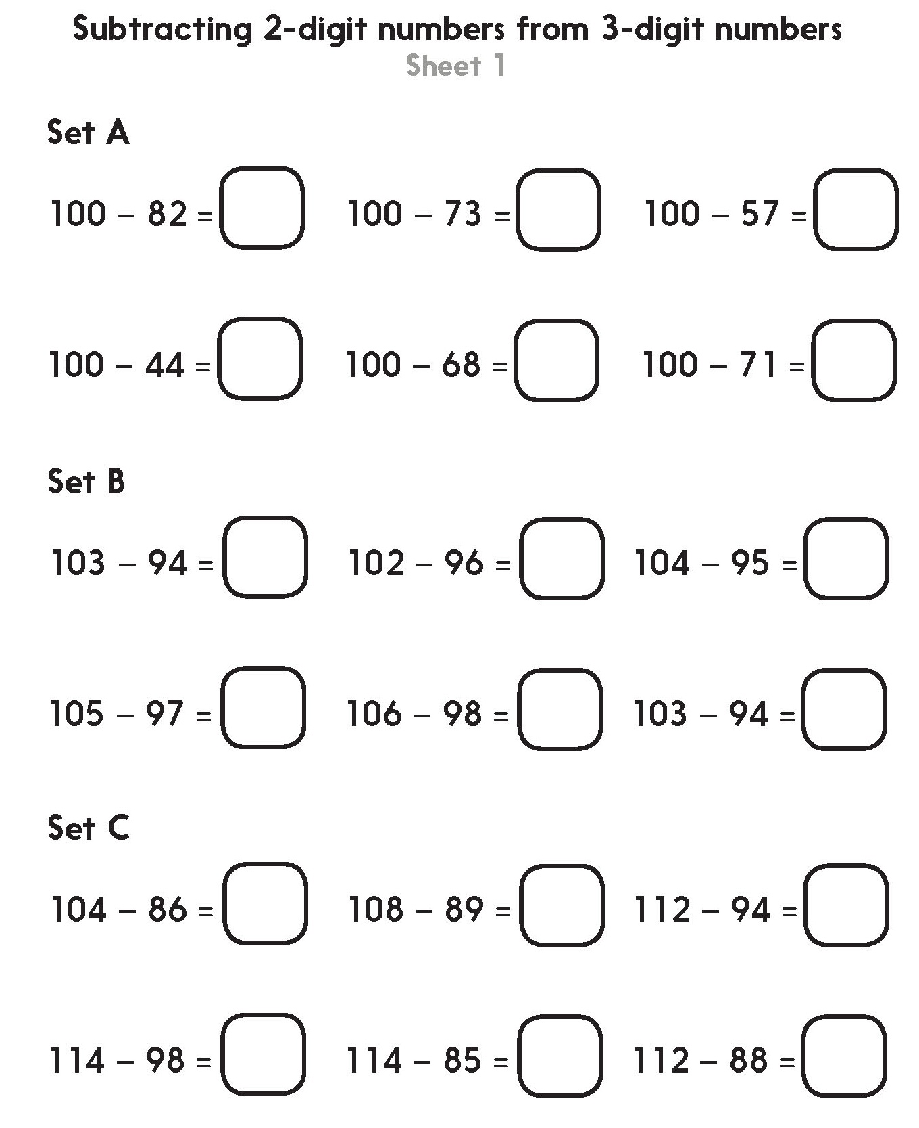
Challenge
Notes:
The Practice Sheet on this slide is suitable for most Y3 children.
Differentiated PRACTICE WORKSHEETS are available on Hamilton’s website in this unit’s PROCEDURAL FLUENCY box.
WT/ARE/GD: Subtracting 2-digit numbers from 3-digit numbers Sheet 1.
Working towards ARE complete Set A using a 0-100 beaded line for reference (see resources), then complete Set B.
Working at ARE complete Set B then the first four questions of Set C.
Greater Depth complete Set B then Set C. Teacher Note: The final 2 questions of Set C have an answer greater than 20 but less than 30.

Slide 36
Challenges
Notes:
The Practice Sheet on this slide is suitable for most Y4 children.
Differentiated PRACTICE WORKSHEETS are available on Hamilton’s website in this unit’s PROCEDURAL FLUENCY box.
WT/ARE/GD: Subtracting 3-digit numbers Sheet 2.
Working towards ARE complete Bronze and Challenge.
Working at ARE complete Bronze, Silver and Challenge.
Greater Depth complete 3 from Bronze, 3 from Silver and all of Gold and both Challenges.

Slide 37
Addition and Subtraction
Counting up subtraction (Frog)
Objectives
Day 4
Use counting up (Frog) to subtract numbers either side of 100, e.g. 112 - 86.
Use counting up (Frog) to subtract numbers either side of a multiple of 100, e.g. 432 - 356; Check subtraction with addition.

Slide 38
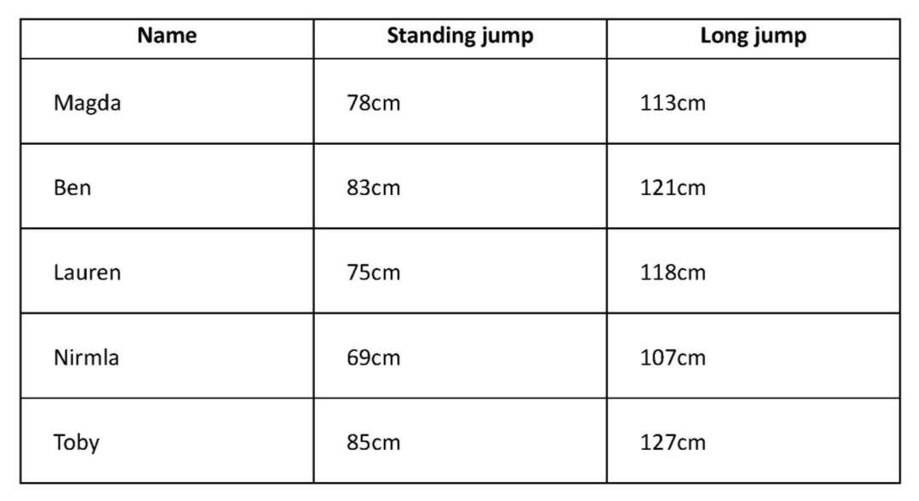
Day 4: Use counting up (Frog) to subtract numbers either side of 100, e.g. 112 - 86.
Use counting up (Frog) to subtract numbers either side of a multiple of 100, e.g. 432 - 356; Check subtraction with addition.
The table shows the difference between children’s standing jump and long jump.
Let’s see how Frog can help us find the difference between the jumps for each child.

Slide 39
Day 4: Use counting up (Frog) to subtract numbers either side of 100, e.g. 112 - 86.
Use counting up (Frog) to subtract numbers either side of a multiple of 100, e.g. 432 - 356; Check subtraction with addition.
Magda’s long jump was 113cm and her standing jump was 78cm.
The difference between Magda’s jumps is 35cm.
113 - 78 = 35.
Can you say why?
Frog first hops 2 to 80…
… finally 13 to 113.
… and then 20 to 100...
2
20
13
78
80
100
113

Slide 40
Day 4: Use counting up (Frog) to subtract numbers either side of 100, e.g. 112 - 86.
Use counting up (Frog) to subtract numbers either side of a multiple of 100, e.g. 432 - 356; Check subtraction with addition.
121 - 83 = ?
Add the jumps!
Ben’s long jump was 121cm and his standing jump 83cm.
The difference between Ben’s jumps is 38cm.
Frog first hops 7 to 90…
… and then 10 to 100...
… finally 21 to 121.
7
10
21
83
90
100
121

Slide 41
Day 4: Use counting up (Frog) to subtract numbers either side of 100, e.g. 112 - 86.
Use counting up (Frog) to subtract numbers either side of a multiple of 100, e.g. 432 - 356; Check subtraction with addition.
35cm
In pairs choose one of the other children, and find the difference between their jumps.
38cm
Draw a line on your whiteboards and remember to put the jumps above the line.

Slide 42
Day 4: Use counting up (Frog) to subtract numbers either side of 100, e.g. 112 - 86.
Use counting up (Frog) to subtract numbers either side of a multiple of 100, e.g. 432 - 356; Check subtraction with addition.
Let’s check Lauren. Her long jump was 118cm and her standing jump 75cm.
The difference between Lauren’s jumps is 43cm.
Add 20, 18 and 5.
Frog first hops 5 to 80…
… and then 20 to 100...
… finally 18 to 118.
5
20
18
75
80
100
118

Slide 43
Day 4: Use counting up (Frog) to subtract numbers either side of 100, e.g. 112 - 86.
Use counting up (Frog) to subtract numbers either side of a multiple of 100, e.g. 432 - 356; Check subtraction with addition.
Let’s check Nirmla. Her long jump was 107cm and her standing jump 69cm.
Add 30, 7 and 1.
The difference between Nirmla’s jumps is 38cm.
Frog first hops 1 to 70…
… and then 30 to 100...
… finally 7 to 107.
1
30
7
69
70
100
107

Slide 44
Day 4: Use counting up (Frog) to subtract numbers either side of 100, e.g. 112 - 86.
Use counting up (Frog) to subtract numbers either side of a multiple of 100, e.g. 432 - 356; Check subtraction with addition.
Let’s check Toby. His long jump was 127cm and his standing jump 85cm.
The difference between Toby’s jumps is 42cm.
Add 27, 10 and 5.
… and then 10 to 100...
Frog first hops 5 to 90…
… finally 27 to 127.
5
10
27
85
90
100
127
Notes:
Y3 children can now go on to do differentiated GROUP ACTIVITIES. You can find Hamilton’s group activities in this unit’s TEACHING AND GROUP ACTIVITIES download.
WT/ARE/GD: Making subtractions: 2-digit from 3-digit numbers with answers less than 40.

Slide 45
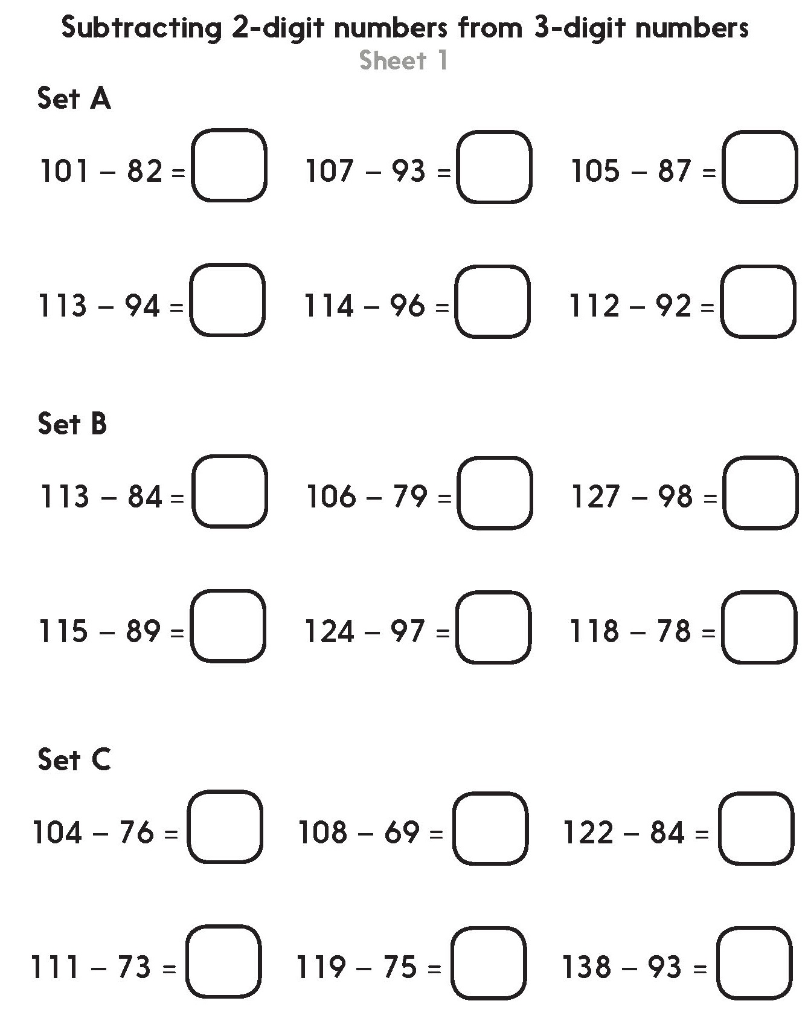
Challenge
Notes:
The Practice Sheet on this slide is suitable for most Y3 children.
Differentiated PRACTICE WORKSHEETS are available on Hamilton’s website in this unit’s PROCEDURAL FLUENCY box.
WT/ARE/GD: Subtracting 2-digit numbers from 3-digit numbers Sheet 1.
Working towards ARE complete Set A and some of Set B (if they can). Children sketch empty number lines and hops as appropriate.
Working at ARE complete Set B then the first four questions of Set C.
Greater Depth complete Set B then Set C. (Teacher Note: The final 2 questions of Set C have an answer greater than 40 but less than 50.)

Slide 46
Day 4: Use counting up (Frog) to subtract numbers either side of a multiple of 100, e.g. 432 - 356; Check subtraction with addition.
421 - 356… How do you think we can solve this?
Add all the numbers above the line…
Draw a line and mark on 356 and 421.
421 - 356 = 65
Jump 4 to 360…
…then 40 to 400…
… finally 21 to 421.
4
40
21
356
360
400
421

Slide 47
Day 4: Use counting up (Frog) to subtract numbers either side of a multiple of 100, e.g. 432 - 356; Check subtraction with addition.
Let’s try 534 - 479.
So 534 - 479 =
Number facts can help! What do you add to 79 to get to 100?
34 more to 534.
21
34
479
500
534
We can do that in one jump!

Slide 48
Day 4: Use counting up (Frog) to subtract numbers either side of a multiple of 100, e.g. 432 – 356; Check subtraction with addition.
Talk to your partner – how can we check the answer?
We used Frog to calculate that
534 - 479 = 55.
534
479
55
479
+ 55
479
+ 55
11
534
If we add 55 to 479 the answer should be 534! Check on your whiteboards.
✓

Slide 49
Day 4: Use counting up (Frog) to subtract numbers either side of a multiple of 100, e.g. 432 – 356; Check subtraction with addition.
416
Peter used Frog and said ‘416 - 363 = 53’.
363
53
363
+ 53
363
+ 53
1
416
✓
Check that on your whiteboards by adding 53 to 363.
You could also check by counting on 50 from 363 and then 3 more.
Notes:
Y4 children can now go on to do differentiated GROUP ACTIVITIES. You can find Hamilton’s group activities in this unit’s TEACHING AND GROUP ACTIVITIES download.
WT: Subtract 3-digit numbers from multiples of 100 and check using addition.
ARE/GD: Subtract 3-digit numbers to find given differences and check using addition to find incorrect answers.

Slide 50
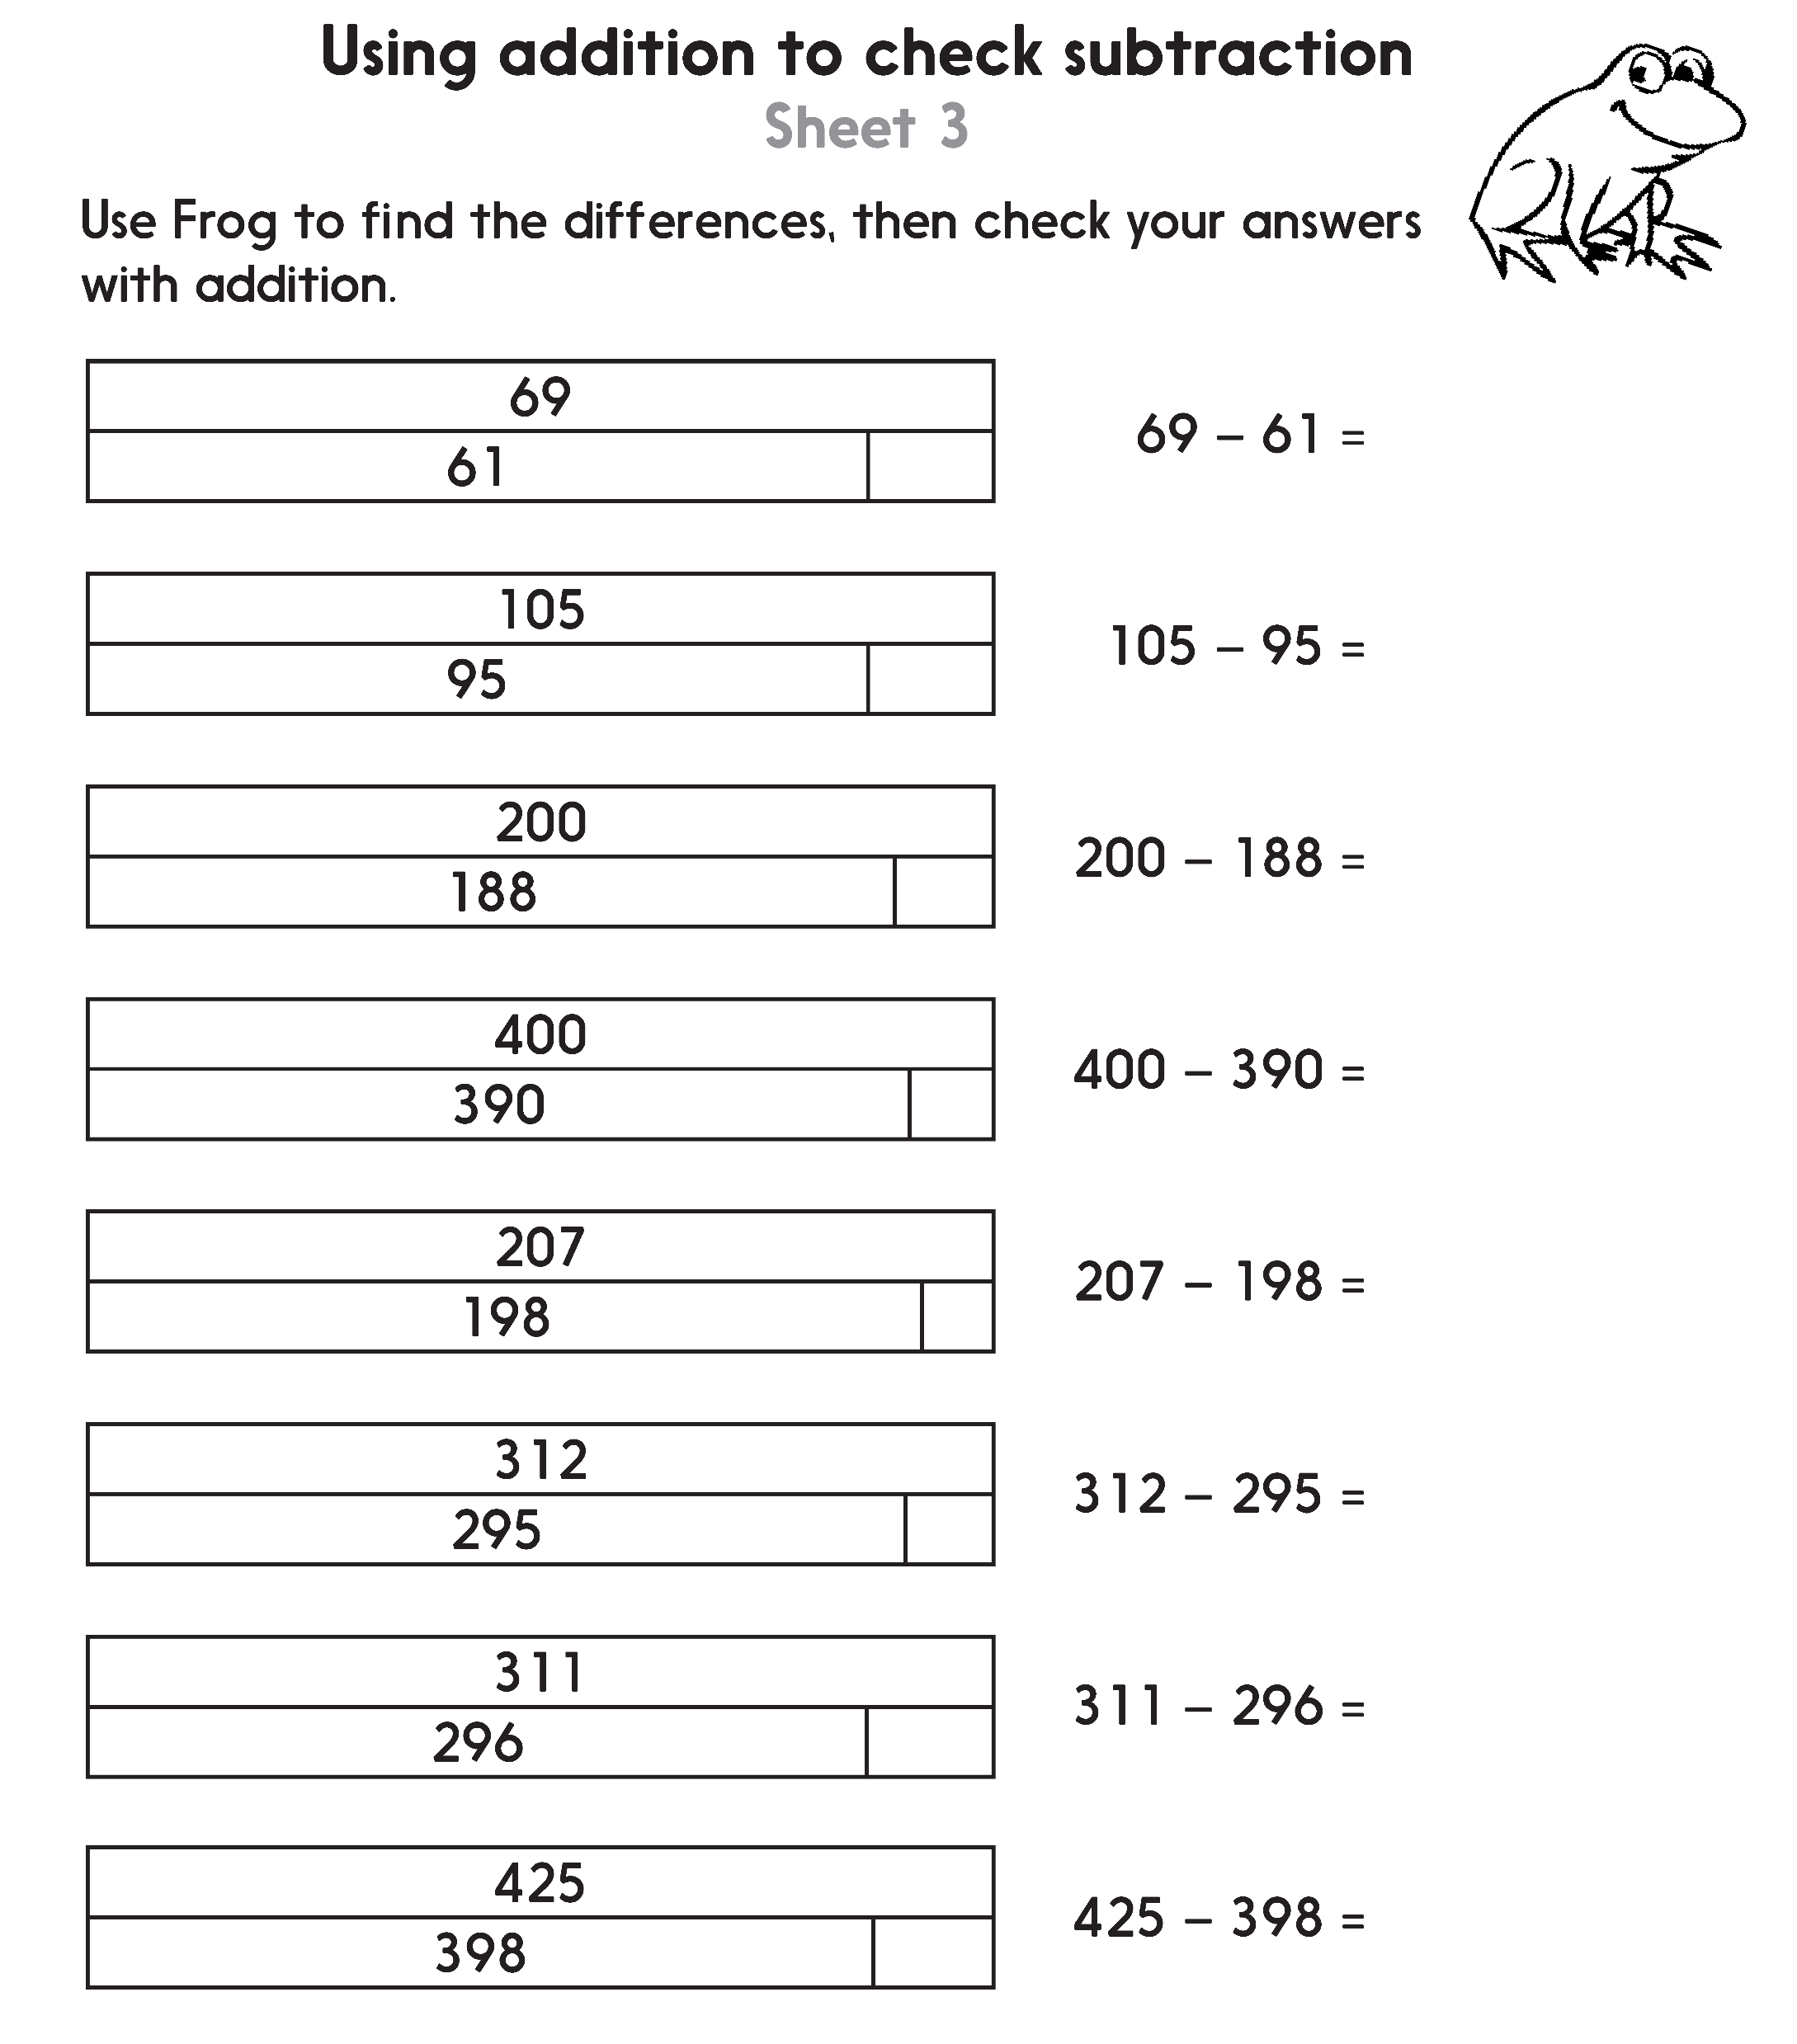
Challenge
Notes:
The Practice Sheet on this slide is suitable for most Y4 children.
Differentiated PRACTICE WORKSHEETS are available on Hamilton’s website in this unit’s PROCEDURAL FLUENCY box.
WT: Using addition to check subtraction Sheet 2.
ARE/GD: Using addition to check subtraction Sheet 3.

Slide 51
Addition and Subtraction
Counting up subtraction (Frog)
Well Done! You’ve completed this unit.
Objectives
Day 1
Use ‘Frog’ (counting up) to subtract pairs of 2-digit numbers (answers <20).
Use ‘Frog’ (counting up) to subtract pairs of 2-digit numbers (answers >20).
Day 2
Use ‘Frog’ (counting up) to subtract pairs of 2-digit numbers (answers <30).
Subtract 2-digit numbers from numbers >100. Explore use of counting up and counting back, discussing choice of method.
Day 3
Use counting up (Frog) to subtract numbers either side of 100, e.g. 102 - 86.
Use counting up (Frog) to subtract numbers either side of a multiple of 100,
e.g. 402 - 356.
Day 4
Use counting up (Frog) to subtract numbers either side of 100, e.g. 112 - 86.
Use counting up (Frog) to subtract numbers either side of a multiple of 100,
e.g. 432 - 356; Check subtraction with addition.
Notes:
You can now use the Mastery: Reasoning and Problem-Solving questions to assess children’s success across this unit. Go to the next slides.

Slide 52
Problem solving and reasoning questions
Year 3
Write 3 different subtractions where Frog does 2 hops and they are both 7.
Use Maths Frog to help you write the missing digits:
7 ☐ – 4 8 = 3 4
☐ 5 – 2 7 = 6 ☐
Write 3 pairs of numbers, each having a difference of 17. One of the numbers must be more than 100, the other must be less than 100.

Slide 53
Problem solving and reasoning answers
Year 3
Write 3 different subtractions where Frog does 2 hops and they are both 7. 37 – 23, 57 – 33, 107 – 93. In each case the first hop of 7 takes Frog to a multiple of 10.
Use Maths Frog to help you write the missing digits:
7 2 – 4 8 = 3 4
9 5 – 2 7 = 6 8
Write 3 pairs of numbers, each having a difference of 17. One of the numbers must be more than 100, the other must be less than 100.
16 possible answers:
116 and 99, 115 and 98, 114 and 97 ………….. 101 and 84.

Slide 54
Problem solving and reasoning questions
Year 4
Describe how you will complete each of these subtractions:
102 – 67 = ☐
134 – 23 = ☐
113 – 78 = ☐
Find the missing numbers represented in these bar diagrams:
212
157
327
 | 259
534
487

Slide 55
Problem solving and reasoning answers
Year 4
Describe how you will complete each of these subtractions:
102 – 67 = 35 count up: jumps of 3, 30 and 2
134 – 23 = 111 partition 23; subtract 20 then 3
113 – 78 = 35 count up: jumps of 2, 20, 10 and 3
Find the missing numbers represented in these bar diagrams:
These are best solved by starting with the smaller number and counting up using complements/ Frog jumps to get to the next 100 or the larger number. In each case Frog should stop at the next multiple of 100.
212
157 | 55
327
68 | 259
534
487 | 47

