Slide 1
Addition and Subtraction
Subtraction: Frog with 3-digit numbers
Objectives
Day 1
Use counting up (Frog) to subtract, e.g. 402 – 356.
Day 2
Use counting up (Frog) to subtract (e.g. 421 – 356) and check with addition.
Day 3
Using counting up (Frog) to subtract and check with addition.
Notes:
Before teaching, be aware that:
On Days 1, 2 and 3 children will need whiteboards and pens.
On Day 3 you will need a flipchart to list children’s ‘help list’ for solving subtractions and checking. Children need copies of the ‘Subtraction Nasty’ game board and sets of 0-9 cards.

Slide 2
Addition and Subtraction
Subtraction: Frog with 3-digit numbers
Starters
Day 1
Pairs to 100 (pre-requisite skills)
Day 2
Change from £1 (pre-requisite skills)
Day 3
Add pairs of 2-digit numbers, answer < 100 (simmering skills)
Notes:
Choose starters that suit your class by dragging and dropping the relevant slide or slides below to the start of the teaching for each day.

Slide 3
Addition and Subtraction
Subtraction: Frog with 3-digit numbers
Starter
Pairs to 100
Notes:
Pre-requisite skills – to use this starter, drag this slide to the start of Day 1
Play ‘Ping-Pong complements to 100’. Say a number, children respond with its complement to 100. Begin with multiples of 10 then use any 2-digit number: Ping 76, Pong 24. Encourage a quick response.

Slide 4
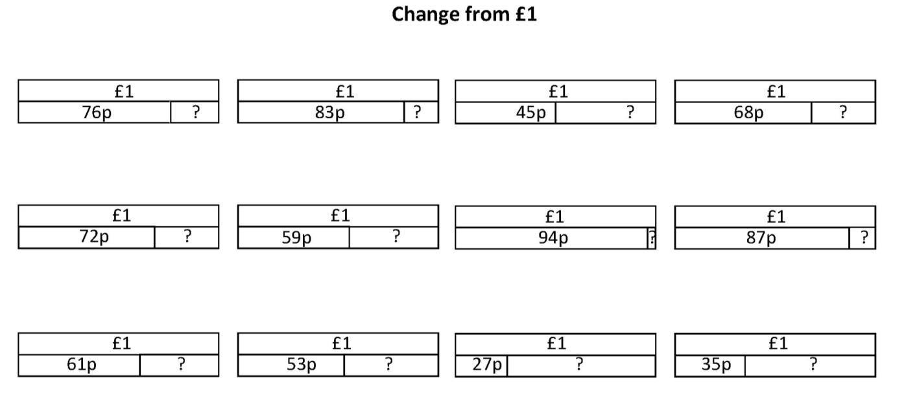
Addition and Subtraction
Subtraction: Frog with 3-digit numbers
Starter
Change from £1
Notes:
Pre-requisite skills – to use this starter, drag this slide to the start of Day 2
Show children a bar model picture for finding change from £1 (see resources). Explain that this picture shows that someone had a pound and spent 76p and the blank bar represents the change from £1. Ask children to write the change from £1 on their whiteboards. Repeat for each picture.

Slide 5
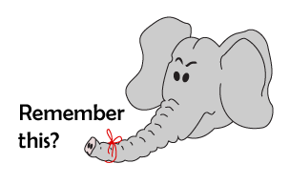
Addition and Subtraction
Subtraction: Frog with 3-digit numbers
Starter
Add pairs of 2-digit numbers, answer < 100
Soccer Math – Adding 2-digit numbers
Notes:
Simmering skills – to use this starter, drag this slide to the start of Day 3
Play ‘Soccer Math – Adding 2-digit numbers’ (www.math-play.com/soccer-math-adding-two-digit-whole-numbers/adding-two-digit-numbers.html). Encourage children to look at the possible answers and discuss how they know some of the answers cannot be correct. Ideally, play individually or in pairs using mobile devices.

Slide 6
Addition and Subtraction
Subtraction: Frog with 3-digit numbers
Objectives
Day 1
Use counting up (Frog) to subtract, e.g. 402 – 356.

Slide 7
Day 1: Use counting up (Frog) to subtract, e.g. 402 – 356.
Remember how to count up to subtract?
Start at the smaller number; use number facts/ place value to jump to the next 10, then to the next 100, add the jumps.
Let’s try 402 – 356.
So 402 – 356 = ?
…then 40 to 400…
Hop 4 to 360…
… finally 2 to 402.
4
40
2
356
360
402
400

Slide 8
Day 1: Use counting up (Frog) to subtract, e.g. 402 – 356.
Let’s try 513 – 469…
So 513 – 469 = ?
Add all the numbers above the line…
…then 30 to 500…
Hop 1 to 470…
… finally 13 to 513.
1
30
13
469
470
500
513

Slide 9
Day 1: Use counting up (Frog) to subtract, e.g. 402 – 356.
Ruth is cycling from one coast of England to the other. The whole route is 203 miles long, and she’s cycled 156 miles. How can we find out how far she has to go?
So 203 – 156 = 47
Explain why…
…then 3 to 203.
Jump 44 to 200…
44
3
156
200
203

Slide 10
Day 1: Use counting up (Frog) to subtract, e.g. 402 – 356.
Let’s try 612 – 565.
So 612 – 565 = ?
…then 12 more to 612.
Jump 35 to 600…
35
12
565
Aim for 600…
600
612
Notes:
Children can now go on to do differentiated GROUP ACTIVITIES. You can find Hamilton’s group activities in this unit’s TEACHING AND GROUP ACTIVITIES download.
WT: Use spinners (Sheet 1) to generate subtractions from 400 or 500.
ARE: Use spinners (Sheet 2) to generate subtractions crossing over a hundred, encourage 2 jumps.
GD: Use spinners (Sheet 3) to generate subtractions crossing over a hundred, encourage 2 jumps (larger differences).

Slide 11
Notes:
The Practice Sheet on this slide is suitable for most children.
Differentiated PRACTICE WORKSHEETS are available on Hamilton’s website in this unit’s PROCEDURAL FLUENCY box.
WT: Subtracting 3-digit numbers: Bronze and Challenge.
ARE: Subtracting 3-digit numbers: Bronze, Silver and Challenge.
GD: Subtracting 3-digit numbers: 3 from Bronze, 3 from Silver and all of Gold and both challenges.

Slide 12
Addition and Subtraction
Subtraction: Frog with 3-digit numbers
Objectives
Day 2
Use counting up (Frog) to subtract (e.g. 421 – 356) and check with addition.

Slide 13
Day 2: Use counting up (Frog) to subtract (e.g. 421 – 356) and check with addition.
Frog wants to solve
421 – 356…
So 421 – 356 = ?
Add all the numbers above the line…
…then 40 to 400…
Hop 4 to 360…
… finally 21 to 421.
4
40
21
356
360
400
421

Slide 14
Day 2: Use counting up (Frog) to subtract (e.g. 421 – 356) and check with addition.
Let’s try 534 – 479.
So 534 – 479 = ?
Number facts can help! What do you add to 79 to make 100?
…then 34 more to 534.
21
34
479
Aim for 500…
500
534
Notes:
Children can now go on to do one of Hamilton’s differentiated GROUP ACTIVITIES, which you will find on the TEACHING AND GROUP ACTIVITIES download.
WT: Use spinners (Sheet 1) to generate subtractions from 400 or 500.
ARE: Use spinners (Sheet 2) to generate subtractions crossing over a hundred, encourage 2 jumps.
GD: Use spinners (Sheet 3) to generate subtractions crossing over a hundred, encourage 2 jumps (larger differences).

Slide 15
Day 2: Use counting up (Frog) to subtract (e.g. 421 – 356) and check with addition.
Talk to your partner – how can we check the answer?
We used Frog to calculate that
534 – 479 = 55
534
479
55
479
+ 55
479
+ 55
11
534
If we add 55 to 479 the answer should be 534! Check on your whiteboards.
✓

Slide 16
Day 2: Use counting up (Frog) to subtract (e.g. 421 – 356) and check with addition.
Peter used Frog and said ‘416 – 363 = 53’
416
363
53
363
+ 53
Check that on your whiteboards by adding 53 to 363.
363
+ 53
1
416
✓
Notes:
Today would be a great day to use a problem-solving investigation – Cats and Dogs – as the group activity, which you can find in this unit’s IN-DEPTH INVESTIGATION box on Hamilton’s website.
Alternatively, children can now go on to do differentiated GROUP ACTIVITIES. You can find Hamilton’s group activities in this unit’s TEACHING AND GROUP ACTIVITIES download.
WT: Use counting up (Frog) to subtract from a multiple of 100 (e.g. 400 – 356) and check with addition.
ARE: Subtracting 3-digits numbers and using addition to check (see resources for questions).
GD: Subtracting 3-digits numbers and using addition to check (see resources for questions).

Slide 17
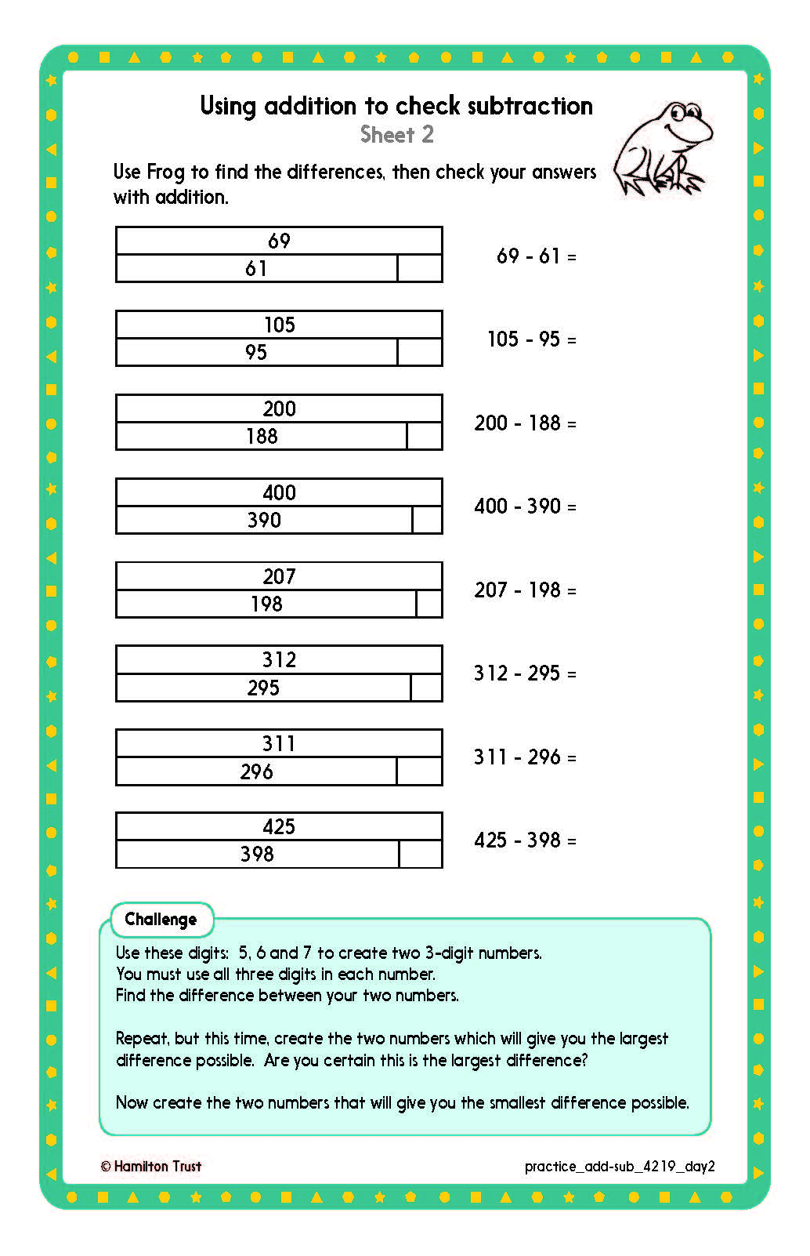
Challenge
Challenge
Notes:
The Practice Sheet on this slide is suitable for most children.
Differentiated PRACTICE WORKSHEETS are available on Hamilton’s website in this unit’s PROCEDURAL FLUENCY box.
WT: Using addition to check subtraction: Sheet 1.
ARE: Use Frog to find differences, then use addition to check subtraction: Sheet 2.
GD: Subtraction word problems: Sheet 3.

Slide 18
Addition and Subtraction
Subtraction: Frog with 3-digit numbers
Objectives
Day 3
Using counting up (Frog) to subtract and check with addition.

Slide 19
Day 3: Using counting up (Frog) to subtract and check with addition.
Talk to your partner…
What are the ways we know to use Frog to solve subtraction and then check using addition?
Let’s collect your ideas to make a poster…

Slide 20
Day 3: Using counting up (Frog) to subtract and check with addition.
685
+ 37
11
722
Let’s check our ideas with 722 – 685.
Check with addition.
✓
What do you add to 685 to make 700?
… jump 22 more to 722.
Add the jumps.
22 + 15 = ?
15
22
685
700
722
Mark on 700…

Slide 21
Day 3: Using counting up (Frog) to subtract and check with addition.
Let’s play the Subtraction ‘Nasty game’!
You and your partner each have a grid...
Player 1
Player 2
Take it in turns to take a 0-9 card…
…and place it on either grid.

Slide 22
Day 3: Using counting up (Frog) to subtract and check with addition.
When each player has 6 numbers on their grid…..
… write a subtraction, larger number first.
Player 1
Player 2
2
7
5
8
0
3
3
4
1
6
8
9
Player 1: 341 – 275
Player 2: 803 - 689
The winner is the person whose answer is closest to 50.

Slide 23
Day 3: Using counting up (Frog) to subtract and check with addition.
275
+ 66
11
341
Let’s check Player 1 341 – 275.
Check with addition.
✓
What do you add to 275 to make 300?
… jump 41 more to 341.
Add the jumps.
25 + 41 = ?
25
41
275
300
341
Mark on 300…

Slide 24
Day 3: Using counting up (Frog) to subtract and check with addition.
Let’s check Player 2 803 – 689.
689
+ 114
11
803
Check with addition...
✓
What do you add to 689 to make 700?
… jump 103 more to 803.
Add the jumps.
11 + 103 = ?
11
103
689
700
803
Mark on 700…

Slide 25
Day 3: Using counting up (Frog) to subtract and check with addition.
Subtraction Nasty game rules!
You and your partner each have a grid like this:
Take it in turns to pick a 0-9 card.
Place it on either grid.
When each player has 6 numbers on their grid write a subtraction, larger number first.
Use Frog to solve the subtraction and add to check.
The winner is the person whose answer is closest to 50.
Play again!
Notes:
Children can now go on to do differentiated GROUP ACTIVITIES. You can find Hamilton’s group activities in this unit’s TEACHING AND GROUP ACTIVITIES download.
WT: Play Subtraction Nasty Game in groups with teacher or teacher support.
ARE: Play Subtraction Nasty Game
GD: Play Subtraction Nasty Game then change rule so that the closest to 100 wins.

Slide 26
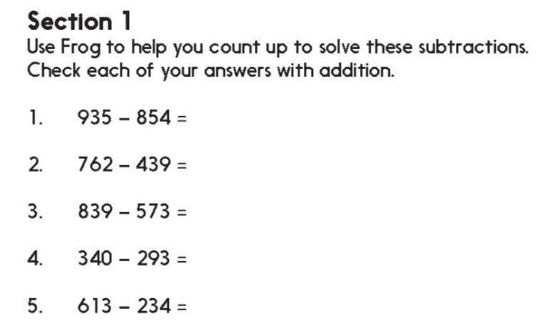
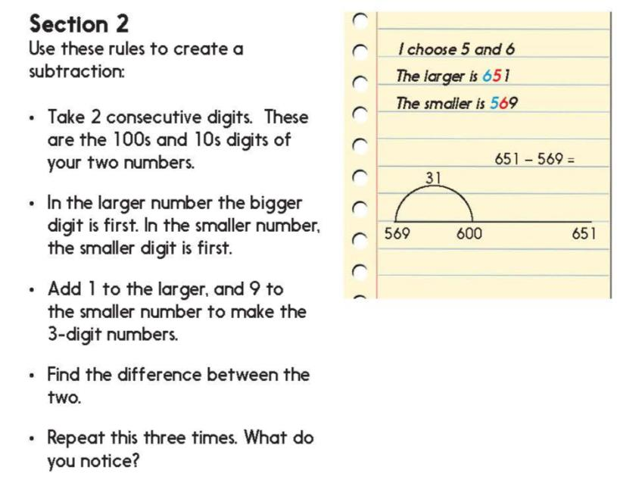
Challenge
Notes:
The Practice Sheet on this slide is suitable for most children.
Differentiated PRACTICE WORKSHEETS are available on Hamilton’s website in this unit’s PROCEDURAL FLUENCY box.
WT: Go straight to Challenge. They follow the same instructions BUT do not add the 1 and 9 leaving both numbers as multiples of 10, e.g. 650 – 560. They still use Frog to find the differences.
ARE: Section 1 and Challenge.
GD: Section 1 and Challenge.

Slide 27
Addition and Subtraction
Subtraction: Frog with 3-digit numbers
Well Done! You’ve completed this unit.
Objectives
Day 1
Use counting up (Frog) to subtract, e.g. 402 – 356.
Day 2
Use counting up (Frog) to subtract (e.g. 421 – 356) and check with addition.
Day 3
Using counting up (Frog) to subtract and check with addition.
Notes:
You can now use the Mastery: Reasoning and Problem-Solving questions to assess children’s success across this unit. Go to the next slide.

Slide 28
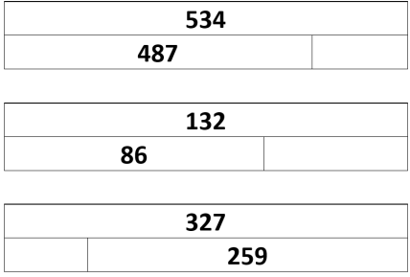
Problem solving and reasoning questions
Complete each diagram
Subtract 377, then 387, then 397 from 424.
Find the difference between a pair of three-digit numbers each of whose digits adds to 9,
e.g. 306 – 261.
Add the digits of your answer. Repeat three times.
Say what you notice.

Slide 29
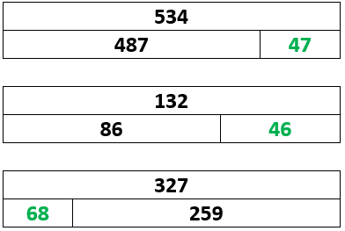
Problem solving and reasoning answers
Complete each diagram
Subtract 377, then 387, then 397 from 424. 47, 37 and 27 respectively. Each time 10 more is subtracted so the answer is 10 less. Are children able to make the connection between the solutions or do they treat each one as a discrete calculation?
Find the difference between a pair of three-digit numbers each of whose digits adds to 9, e.g. 306 – 261. Add the digits of your answer. Repeat three times.
Say what you notice. Digits always total a multiple of 9, for example:
711 – 126 = 585 - Digits total 18
432 – 315 = 117 - Digits total 9
612 – 333 = 279 - Digits total 18

