Slide 1
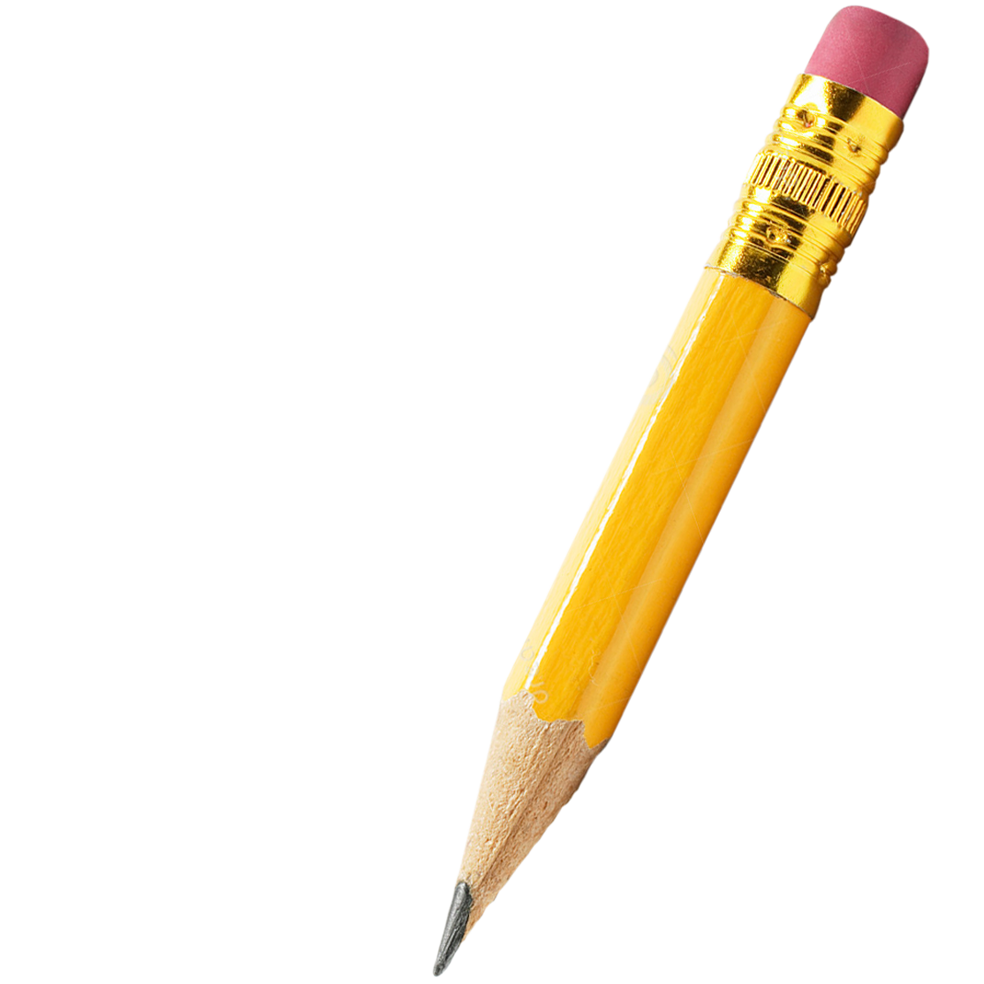
Writing Challenges 1-6
Year 4
Remote Learning, Weeks 3&4

Slide 2
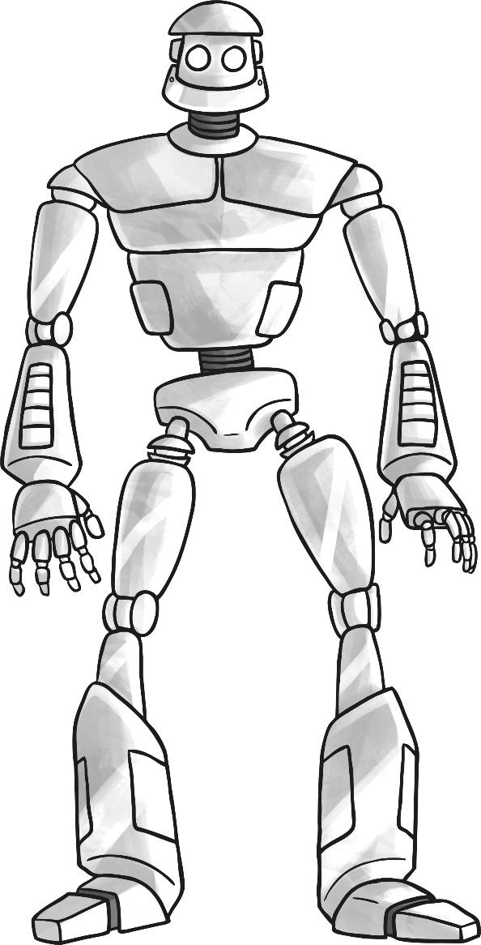
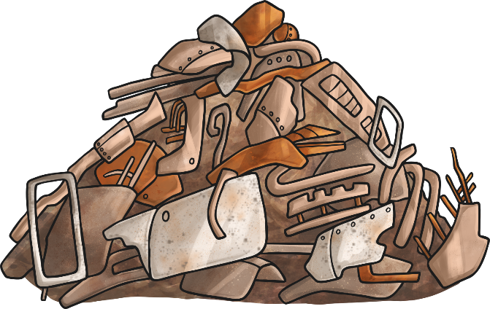
Challenge 1:
Make sure you have read or listened to Chapter 1 of The Iron Man (see reading folder)
L.I. To create an imaginative character
Your first task to design your own robot character for a story you are going to write later (template available).
Think about:
What does he/she look like?
Where did he/she come from?
Who made your robot and what materials did they use?
What special skills does your robot have and how might these help in an adventure?

Slide 3
Challenge 2:
Make sure you have read or listened to Chapter 2 of The Iron Man (see reading folder)
L.I. To use imaginative vocabulary
Rewrite the paragraphs, changing all the words or phrases that are underlined to more impressive ones (see sheet).
Think about:
What does the word that is already used mean?
What other words mean the same thing as that word?
Which is the most impressive and fits the sentence best?

Slide 4
Challenge 3:
Make sure you have read or listened to Chapter 3 of The Iron Man (see reading folder)
L.I. To write a personal letter
Imagine you are Hogarth and you are feeling very guilty about trapping the Iron Man. Write a letter of apology explaining how you feel (template available).
Try to include:
A summary of what happened and why you think you need to say sorry
How you intend to make up for your actions
The correct letter layout – who it’s to and from

Slide 5
Challenge 4:
Make sure you have read or listened to Chapter 4 of The Iron Man (see reading folder)
L.I. To use persuasive language
Pretend that you are the Iron Man and you are applying for a job. Write about why someone should hire you (template available). Remember to write about your skills and try to be convincing!
Try to include:
Positive language such as ‘I am an excellent builder and am incredibly strong’
Exaggeration e.g. ‘No job is too big, I can do it all!
Powerful adjectives such as ‘intelligent’, ‘energetic’

Slide 6
Challenge 5:
Make sure you have read or listened to Chapter 5 of The Iron Man (see reading folder)
L.I. To write a newspaper report
Write a newspaper report about how the Iron Man defeated the space-bat-angel-dragon and became the world’s hero (template available).
Try to include:
A short, snappy headline to grab the reader’s attention
A summary of what happened written from the perspective of a reporter
Past tense – you are writing after the event has already happened
Quotes from people who were there or who have something interesting to say about the event
Pictures of the events with captions underneath

Slide 7
Challenge 6:
Make sure you have read or listened to Chapter 5 of The Iron Man (see reading folder)
L.I. To write a story with a clear structure
Plan and write an imaginative story with a clear opening, build up, problem, resolution and ending (plan and writing frame available). Use the robot character that you created in challenge 1 to help you do this.
Try to include:
The correct structure as detailed in the story mountain
Excellent VCOP – vocabulary, connectives, openers and punctuation
Correct paragraphs
An ending which isn’t just, ‘They all went home and lived happily ever after.’

