Slide 1
The Iron Man
By Ted Hughes
Scheme of work created by K. Sumner

Slide 2
Chapter 1
Audiobook: https://www.youtube.com/watch?v=ycgfA-7udHs
Task 1
List as many similes as you can from this chapter.
What do all these similes have in common? (HINT: What are they describing?)
What time of day do you think it is when the Iron Man falls off the cliff? How do you know this? (HINT: There are two clues in the text)
Why do you think the seagull picked up one of the Iron Man’s eyes?
Write down 5 verbs from this chapter (Remember, a verb is a doing word)

Slide 3
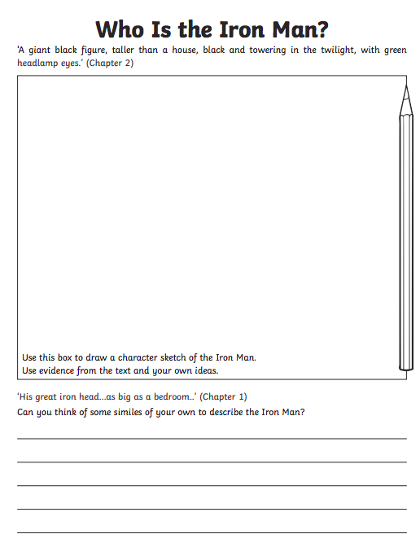
Task 2
Print out this template from the reading folder and complete.
Or, on a separate piece of paper, write the title, draw a box with a ruler and complete the drawing. Underneath write your own similes to describe the Iron Man.
Remember to use evidence from the text to inform your drawing. You could even label your drawing with adjectives and descriptive phrases from the book.

Slide 4
Chapter 2
Audiobook:
https://www.youtube.com/watch?v=8TvcRzzzs44
Task 3
Was Hogarth’s fishing trip successful? Explain how you know.
From whose point of view is the story written? Is it first, second or third person?
Why do you think one of the farmer’s didn’t believe Hogarth’s father about the Iron Man?
What do you think the Iron Man would have done with Hogarth’s father if he had caught him? (Think about whether you think the Iron Man is dangerous or not)
The farmers dug a ginormous hole to trap the Iron Man. How would you try to capture him?
What does Hogarth feel at the beginning of the chapter compared to the end of the chapter?

Slide 5
Task 4
This book was written in 1968.
Find out how robots have developed over time.
What were robots like then? What are they like now?
Put this information either into a paragraph of text with pictures below or create an informative poster.
Useful Links:
https://kids.kiddle.co/Robot
https://www.timeforkids.com/g2/robots-at-work/
https://kidsdiscover.com/teacherresources/all-about-robots/

Slide 6
Chapter 3
Audiobook:
https://www.youtube.com/watch?v=q_wgcrIX5iM
Task 5
Sequencing
Write down these events, in the order in which they happened
The farmers wanted to call the Army, but Hogarth had a bright idea
The father felt the ground shake
All of the food fell into a crack in the ground
One day, a family had a picnic on the top of the hill
Terrified, the family ran to the car
An enormous hand appeared out of the ground

Slide 7
Task 6
Create a menu for the Iron Man.
Remember that he likes to eat things out of metal. Use the same style as Ted Hughes by combining real food with metal objects. For example: ‘spaghetti barbed wire’ or ‘roast tractor with diesel gravy’
It might help you to first make a list of metal objects and then add names of real food to them.
You can either just write a list of these or you could create a menu like you would see in a restaurant (template available if required). You could even make up some desserts and drinks!

Slide 8
Chapter 4
Audiobook:
https://www.youtube.com/watch?v=NAiU8Hm-4lw&t=20s
Task 7
True or False?
The astronomers were the first to notice that the star was changing
The tiny star was getting smaller and smaller
The star ended up bigger than the moon
On the forth night, the astronomers thought that it might be a bat
The creature landed in London
The space-bat-angel-dragon demanded to be fed living things
The war wounded the space-bat-angel-dragon
Hogarth managed to convince the Iron Man to help
Extension: Can you write some of your own true or false questions on this chapter?

Slide 9
Chapter 5
Audiobook:
https://www.youtube.com/watch?v=HzGQUs6Vcjc&t=52s
Task 8
Why did the Iron Man have to be taken apart?
Why do you think the space-bat-angel-dragon laughed when the Iron Man challenged him to a test of strength?
When the space-bat-angel dragon returned from the sun he looked terrible. Do you feel sorry for him? Explain why or why not.
The Iron Man challenged the space-bat-angel-dragon a third time. How do we know that (despite what he was saying) the Iron Man probably couldn’t go into the firepit again?
What impact did the space-bat-angel dragon’s singing have on the world?

Slide 10
Task 9
After his heroic battle with the space-bat-angel-dragon, the Iron Man was the world’s hero. Everybody in the world sent him a present.
Make a list of 5 countries and decide on a present that each country might send to the Iron Man. Try to make it relevant to that country.

Slide 11
Extension Activities
Plan and record a radio or television news report about the space-bat-angel-dragon’s landing in Australia.
Use craft materials to make your own Iron Man or robot picture/model
Create your own robot character and write a story about him/her
The Iron Man helps the world to become more peaceful. Think of ways we could encourage people to live more peacefully
Draw a map showing the locations within the story
Astronomers spot the growing star in the constellation of Orion. Find out some facts about Orion or research other constellations
Think about the properties of different materials. What might have happened if he was made of wood, plastic, fabric or jelly? Plan an experiment to test the strength of different materials.

Slide 12
Did you enjoy this book?
⭐️⭐️⭐️⭐️⭐️
If so, you may want to read, ‘The Iron Woman’ or watch ‘The Iron Giant’, which is an animated film based on the book.
Scheme of work created by K. Sumner

